Slide 1
3rd Transnational Thematic Meeting Thematic issue: Definition of I4.0 public policy initiatives
19 November 2019, Lisbon

Slide 2
AGENDA
Welcome COMPETE 2020
Thematic issue: “Definition of I4.0 public policy initiatives”
Launch of Action planning
Joint Analysis Report
Introduction to the next thematic issue
1
2
3
4
5

Slide 3
AGENDA
Welcome COMPETE 2020
Thematic issue: “Definition of I4.0 public policy initiatives”
Launch of Action planning
Joint Analysis Report
Introduction to the next thematic issue
1
2
3
4
5

Slide 4
3rd Transnational Thematic Meeting Thematic issue: Definition of I4.0 public policy initiatives
Jaime Andrez
Chairman of the Board MA COMPETE 2020
19 November 2019, Lisbon

Slide 5
PT 2020
COMPETE 2020
Numbers and Figures

Slide 6
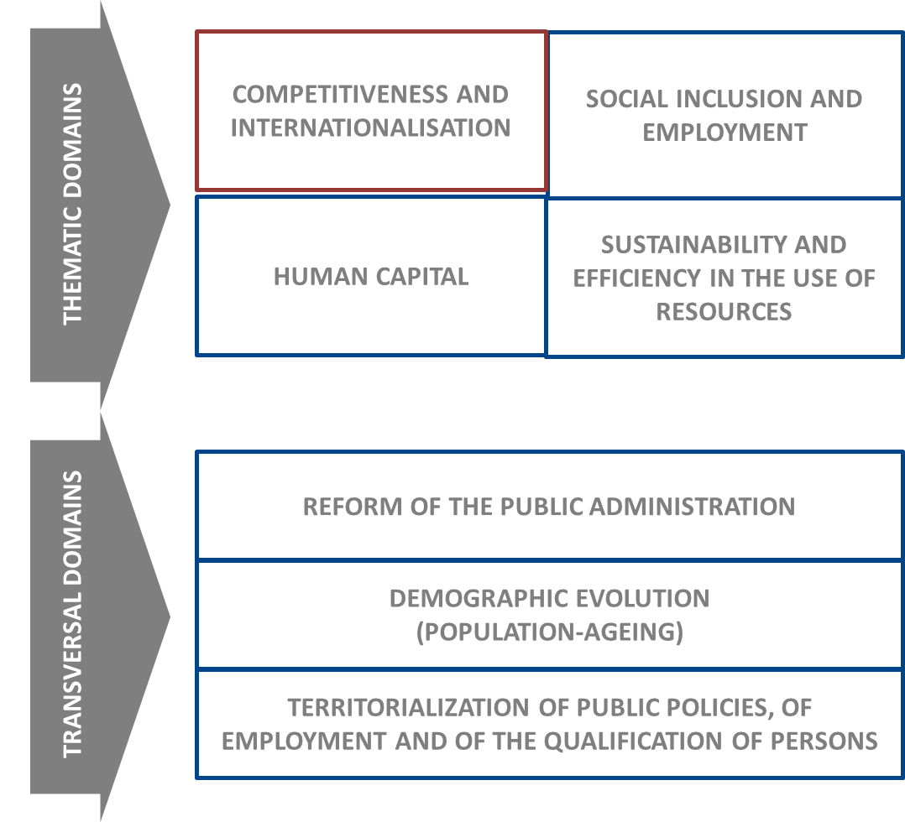
Global Structure:
Operational Programs Chart

Slide 7
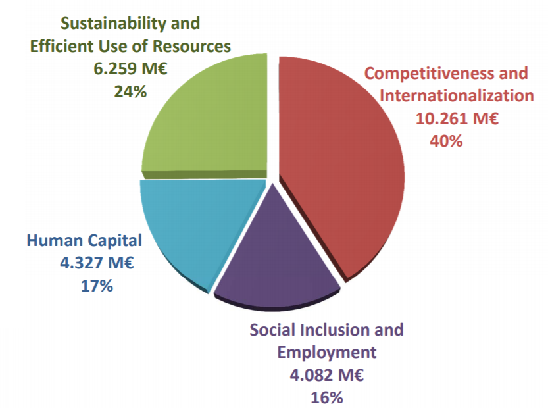
PT 2020 – Fund allocation

Slide 8
PT 2020
COMPETE 2020
Numbers and Figures

Slide 9
COMPETE 2020 – Main Objetive:
OBJECTIVE: improving the competitiveness of enterprises and their internationalisation (in global competitive contexts), creating jobs and generating wealth and well-being
Business support
Business and investment
environment

Slide 10
Environment Support
Support to
Environment
Scientific and technological knowledge
Clusters
Digital Transformation of PA
Collective Efficiency
Sustainable Transports
FIRMS COMPETITIVENES
Investment
Technologies
Financing

Slide 11
Investment Incentives
Support to
INVESTMENT
Investment Diagnosis Opportunities
Training
R&D
Qualification and
Internationalisation
SME
Innovation
FIRMS COMPETITIVENESS
Growth
Creating jobs
Added value

Slide 12
Incentive System Network : Unique Regulation and Information System, as well as a key to allocate projects
Coordination by COMPETE 2020
Allocation key:
Dimension
or
- Investment
Operational Programs
+

Slide 13
Structure and Budget Allocation
ERDF
3.247 M€ (52,1%)
CF
609 M€ (9.8%)
Fundo
ESI
Fund
s
ESF
558 M€ (9,0%)
4.414 M€
70,8%
Private
1.486 M€ (23.8%)
P
National
Public
333 M€ (5,3%)
Expenditure
P
1.819 M€
29,2%
Total Budget
6.233 M€

Slide 14
Funding priorities

Slide 15
Priority Axis
Priority Axis I – Reinforcement of Research and Technological Development and Innovation / 1.400 M€
Priority Axis II – Reinforcement of SME competitiveness / 1.433 M€
Priority Axis III – Promotion of employment quality and sustainability / 396 M€
Priority Axis IV – Promotion of sustainable transports and elimination of bottlenecks on the main infrastructure networks / 709 M€
Priority Axis V – Public sector (and related stakeholders) institutional capacity building and increase in public administration efficiency /

Slide 16
PT 2020
COMPETE 2020
Numbers and Figures

Slide 17
Business Incentive Systems
General overview of the implementation
(million euros)
Itens | PT 2020 | C2020
Number of supported entreprises | 14 873 | 4 217
Total eligible costs | 10 566 367 | 6 446 916
Union co-financing | 5 308 394 | 3 210 591
Data source : SGO 2020 | 31 October 2019

Slide 18
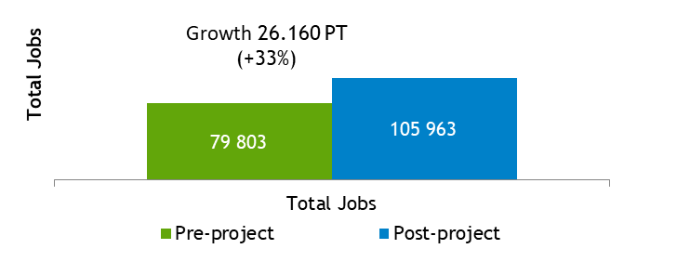
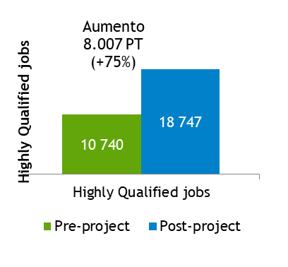
Incentive Systems | Some Results
(Innovation Incentive System)
∆ de T
∆ de EV:
∆ de GVA:
TJ
HQJ

Slide 19
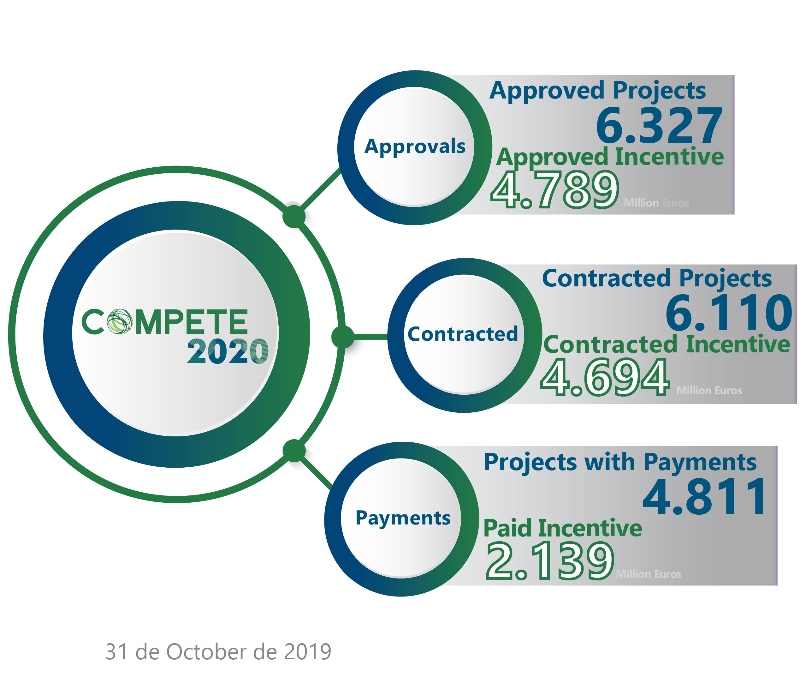
COMPETE2020
General overview of the implementation

Slide 20
Follow us : www.compete2020.gov.pt

Slide 21
AGENDA
Welcome COMPETE 2020
Thematic issue: “Definition of I4.0 public policy initiatives”
Launch of Action planning
Joint Analysis Report
Introduction to the next thematic issue
1
2
3
4
5

Slide 22
Regional Overview and Good Practices
„Definition of I4.0 public policy initiatives”
Ministry of Industry and Trade CR
19 November, 2019 3rd Transnational Thematic Meeting, Lisboa

Slide 23
Regional I.4.0 Public Policy Initiative: – Digital Czech Republic

Slide 24
Digital Czech Republic
Cross-sectional strategic document
Strategy of Coordinated and Comprehensive Digitization of the Czech Republic 2018+
Effects of digitization on the economy and society
Management: the Government Council for the Information Society
Implementation: ministries and offices

Slide 25
3 pillars:
Czech Republic in Digital Europe
Digital Economy and Society
Information Strategy of the Czech Republic

Slide 26
Good Practice ESIF
Aid programme Technology
Priority Axis 2 Development of SMEs’ entrepreneurship and competitiveness Operational Programme Enterprise and Innovations for Competitiveness, ERDF
Support of the projects that have a strategy for further development in the field of digital transformation of the company through the acquisition of new technological equipment
Digital transformation level after a realisation of the project - progress in digital transformation is evaluated

Slide 27
Good Practice ESIF
Aid programme Consulting
Priority Axis 2 Development of SMEs’ entrepreneurship and competitiveness Operational Programme Enterprise and Innovations for Competitiveness, ERDF
Provision of consultancy services for start-ups and development SME
Purchase of consultancy services for SMEs aimed at obtaining new certificates needed for business and industry (certification of products, processes, management systems, etc.)
Purchase of consultancy services for SMEs aimed at developing a digital transformation plan for part or the whole of the applicant's company

Slide 28
Good Practice ESIF
Good practice example:
The company KRUZIK s. r. o.
(traditional manufacturer of sectional residential and industrial doors, gates and entrance doors)
Introducing I4.0:
Using computer numerical control (CNC) machine for pre-drilling holes for hinges (previously doing manually)
The CNC machine communicate with the company‘s information system by QR codes.
Using a number of robots to reduce the workload on employees (automatic autonomous loading system plugged to the internal network)

Slide 29
Good Practice General Policy
Memorandum of Cooperation between Platform for AI, Government Commissioner for Information technology and digitization, Office of the Government of the CR and Ministry of Industry and Trade
Platform for AI: representatives of business, academia and government administrative
Output of common effort:
National Strategy of Artificial Intelligence in the Czech Republic
approved by the government in May 2019

Slide 30
Thank you!
Questions welcome

Slide 31
Regional Overview and Good Practices
„Definition of I4.0 public policy initiatives”
Regional Council of Kainuu, PP8
19 November, 2019 3rd Transnational Thematic Meeting, Lisboa

Slide 32
Regional I.4.0 Public Policy Initiatives
General overview of I.4.0 regional public policy initiatives concerning R&D&I, trainning, qualification, regulations, startups,
Links for site(s) initiatives
Summary
…
2 or 3 pages

Slide 33
National I.4.0 Public Policy Initiatives
In Finland, there is no distinct Industry 4.0 policy.
Industry 4.0 is part of Finland’s overall Industrial, Innovation and Digitisation policies. Digitisation, especially through Artificial Intelligence (AI) initiatives is a policy in its own right involving the uptake & production of AI solutions.
Digitisation policy: Digitisation has been a priority in Finland since the 1990s, and today’s performance is especially encouraging. In December 2017 Finland launched a national artificial intelligence (AI) strategy aiming at turning Finland into a leading country in the application of artificial intelligence.
Finland’s 2014-2020 Structural Funds provide an enabling framework for applying Industry 4.0 solutions. Investment priorities 2 (Investment priority 2. Supporting SMEs so that they can grow in the local, national and international markets and take part in innovative processes; page 43) and 3d (3d - Supporting SMEs so that they can be part of the growth in the local, national and international markets and innovative processes; page 46) provide excellent opportunities for the uptake of Industry 4.0
SOURCE: Policy instrument assessment report for Kainuu region, Finland , January 2019

Slide 34
Regional I.4.0 Public Policy Initiatives
The Kainuu regional development programme
In the Regional Development Programme of Kainuu, Industry 4.0 is described under the Smart Specialisation approach. Industry 4.0 solutions are described as cross-cutting themes through all chosen spearheads of the RIS3 strategy. Digitisation priorities are discussed in appendix 2 (values and cross-cutting views of development work), page 52. In the Regional Action Plan of the Structural Funds and Rural & Agriculture Funding industry 4.0 is emphasised in chapter 1.3.
The prioritised industries of smart specialisation are 1) measurement technology, gaming & simulators, and innovations in metal industry 2) process and environmental monitoring of bio-based economy, mining and innovations of forest, food and blue bio-based economy industries, 3) activity tourism on social and welfare sector and innovations in health and sports sector.
The Kainuu RIS3
The approach of Kainuu Smart Specialisation strategy differs from the traditional development activities of regional spearheads of economic activities by its choice to emphasise high level of know-how, as well as research and innovations and the supporting educational activities. The spearhead fields in general are developed as an entity covering everything from the basic know-how needed to excellence and the infrastructure related to activities.
SOURCE: Policy instrument assessment report for Kainuu region, Finland , January 2019

Slide 35
Regional I.4.0 Public Policy Initiatives
Project criteria for promoting Industry 4.0
Selection process of projects to be funded goes through many stages. After the compulsory prerequisites, project proposals have to prove their relevance to the programme or call.
Industry 4.0 – related proposals have to fulfill at least some of the following criteria.
RDI activities in order to show the technological change project is targeting
RDI cooperation between different RD units or working together with private sector and educational institutions triple helix / quadruple helix
Smart specialization connections to the programme
Knowledge intensive activities
Promoting low carbon economy
Using digitization as a game changer
Projects are supposed to bring added value to whole region through the implementation of the proposals.
SOURCE: Policy instrument assessment report for Kainuu region, Finland , January 2019

Slide 36
Good practices relevant to I.4.0
I.- AWARENESS RAISING & TRAINING / ADOPTION OF I.40 RELATED SOLUTIONS
I.1/ Woodpolis 2020 (1.1.2018–31.12.2020, Total budget 756 000 €, ERDF+state funding 535 600 €): Wood product industry (production) is aiming at the possibilities of digitisation and modern machines & equipment to make production more efficient. Future possibilities, ecology of production (low carbon production), renewable raw material – material wise and production wise (heath/electricity), automation in production. Support services are important part, maintenance and reliability – all need to be digitised in the long run to achieve competitive advantage.
I.2/ BIOMIT (1.1.2017-21.12.2018, Total budget 924 500 €, ERDF+state funding 647 200 €): The BIOMIT project focus is developing measurement and pre-treatment solutions for bio-economy, mining, forest and paper industry to improve their efficiency and decrease toxic emissions to the environment. The project is divided into five work packages: 1) Development and increasing the knowledge of modelling complex processing systems; 2) Development of pre-treatment and measurement solutions for process industry; 3) Pilot tests for measurement solutions in the industry; 4) Development of mathematical models and reliability for data management, 5) Administration, communication and business development (connection to KANTELI project): company and project co-operation.
The main results of the project are: development and piloting 4-5 technologies which improve industrial process control and decrease toxic emissions to the environment and furthermore enable new entrepreneurship in the field of bio-economy in the Kainuu region. 1-2 international pre-reviewed scientific articles / conference papers and national and international project funding.
SOURCE: Policy instrument assessment report for Kainuu region, Finland , January 2019

Slide 37
Good practices relevant to I.4.0
I.- AWARENESS RAISING & TRAINING / ADOPTION OF I.40 RELATED SOLUTIONS
I.3/ Data analytics accelerator (1.5.2018-30.4.2020, Total budget 346 000 €, ERDF+state funding 240 000 €): Data analytics, big data and artificial intelligence are the major tools for modern companies to achieve large-scale competitive advantages. The target of this project is to speed-up the up-take of data analytics methods in regional companies and in the Kainuu region as whole. The project creates a straightorward process for companies and institutions to quickly try out the possibilities of data analytics and to launch new data driven solutions.
The project consists of data analytics pilot projects with approximately 3 companies, workshops with 10-15 companies and outreach activities for even a larger number of companies. This improves the know-how and practical experience of data analytics in the regional businesses significantly. The data-analytics accelerator provides the necessary first push for adapting new methods, which otherwise would required major investments and competence from the participant companies.
The project results in improved usage of data analytics through three channels. The deepest effect comes from pilot projects, where the data analytics capability of the participating companies can be developed on a longer term. Wider reach comes from workshops, where the work focuses on real-world questions posed by the companies and translating the concepts of data analytics into the everyday life of the participants. In addition to these results the project also runs outreach activity to educate local companies and institutions about the possibilities of data analytics and success stories from the project. The project produces quick improvements to companies' processes, but also improved understanding that benefits business development in the long run.
SOURCE: Policy instrument assessment report for Kainuu region, Finland , January 2019

Slide 38
Good practices relevant to I.4.0
II.- I4.0 INNOVATIONS, PRODUCTION & TESTING
II.1/ Robotics for Kainuu (1.2.2016-31.3.2019, Total budget 306 300 €, ERDF+state funding 214 400 €: The aim of this project is to build up facilities for teaching and learning robotics in companies and in learning institutions KUAS and KVC in Kainuu region and to improve and raise the knowledge and skills concerning robotics and automation linked with it. In addition, this will guarantee the sufficiency of professionals in the future.
Two of the learning facilities will be built in companies, robot welding station and movable service robot cell for NC machining. Two facilities will be placed in the learning institutions. They are piece handling and packaging robot cell and stationary service robot cell for NC machining. Moreover, several cooperative robots will be purchased to be used both in companies and learning institutions for many kinds of tasks, as well as health and care robotics competence will be acquired.
SOURCE: Policy instrument assessment report for Kainuu region, Finland , January 2019

Slide 39
Good practices relevant to I.4.0
II.2/ OredVR (1.1.2018-31.12.2019), Total budget 349 900 €, ERDF+state funding 244 900 €): The OredVR project adds to the knowledge on how mining companies can use virtual reality and augmented reality in visualising ore deposits for different user groups in the value chain of a mine. The OredVR project creates a virtual reality/augmented reality platform for visualising ore deposits. This platform utilises the different data mining companies collect from the site, as well as other relevant data (such as market prices) from outside sources. The platform integrates and processes the data to produce that 3D visualisations that can be utilised for different operations with, depending on the need, virtual reality (VR) or augmented reality (AR). It will have separate interfaces for several different users (e.g. executive level, mineral processing personnel, loading personnel, exploration planning). In addition, efficient ways for handling big data in mining environment are developed in the project.
SOURCE: Policy instrument assessment report for Kainuu region, Finland , January 2019
T

Slide 40
I.4.0 Public Policy Initiatives
CONCLUSIONS
Industry 4.0 is not a priority in the current RIS3.
Project criteria relating to I 4.0 exist and we believe they are good.
Several projects have been implemented, we have selected 5 as good practices.
The comprehensive approach is missing.
A more targeted, cohesive and generalised approach relating to I4.0 adoption and in parallel, supporting production of I4.0 innovations seems relevant.
Advanced manufacturing, I4.0 and trans-regional (national, transnational, interregional) solutions for cooperation and access to expertise, will be included in the RIS3 revision (on going call for offers currently).
The above background was important in the elaboration of the 2nd thematic document.

Slide 41
Key findings from the 2nd thematic document
Key benefits
(1) Potential for product customisation: Additive manufacturing is an example of a tool facilitating this process. Additive manufacturing (3D printing, whereby a 3D model is created by CAD software can be used to produce an item by building up successive layers of a material (plastic or metal)).
A first benefit is having the potential to produce much more complex components than before.
A second benefit is how fast and cheaply new / differentiated product components can be produced.
(2) Personalised medication: personalised medication is a patient-focused process that incorporates both, medication and the dispensing process.
(3) Collective constructions internet-based building management systems (e.g. light, temperature, humidity) adapted to each individual resident’s preferences
(4) New market is developing fast towards productising components for Industry 4.0 applications (Building the foundations for an Industrie 4.0 ecosystem: Platform Industrie 4.0 publishes a blueprint for the smart networking of assets).

Slide 42
Key findings from the 2nd thematic document
I4.0 and traditional SMEs
OVERALL FINDING
SMEs’ motivation and readiness towards adopting I 4.0 require straightforward, tailored business model (-s), and such model (-s) is /are missing. Therefore, such models such be included into several policies such as research, education and regional policies.
READINESS FOR ADOPTING I4.0
Conceptual readiness: I4.0 means to a business environment, is about digitising (automating, self-regulating, self-assessing and interlinking) business & production modules
Attitudinal readiness: Traditional SMEs hesitate to invest in advanced solutions unless the relevance of the solutions is demonstrated.
RELEVANCE
Returns to scale: For any business, traditional SMEs included, the trade-offs between investments and gains related to Industry 4.0 must be clearly outlined and demonstrated. Among the most important reasons for SMEs to adopt I4.0 solutions is linking to value chains.

Slide 43
Strategic contribution to the industry renewal: from light pink to light green

Slide 44
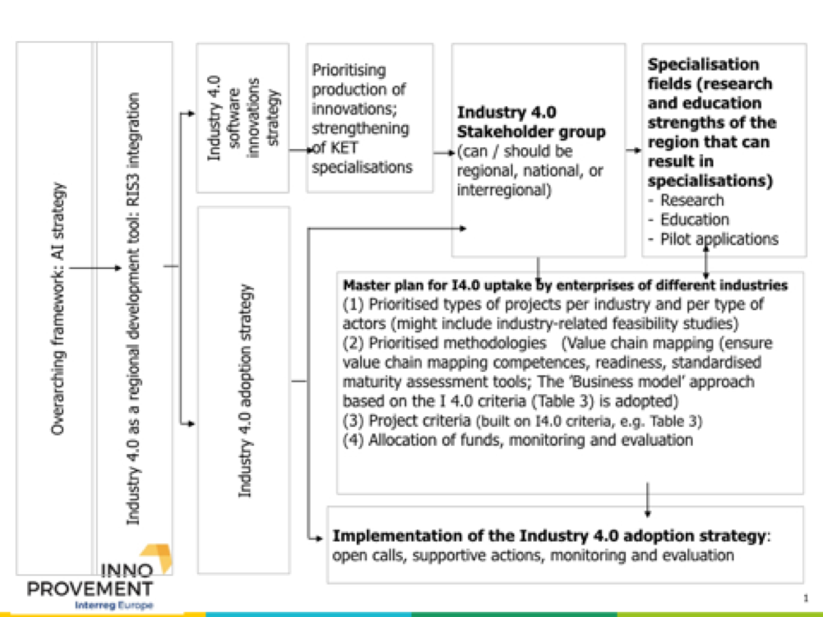
Policy impact in Kainuu, state of play
I 4.0 main concept presented during the 1st RSG, 12-5-2019.

Slide 45
Policy impact in Kainuu
RIS3 impact (on going RIS3 revision & preparation for the next period)
Introducion to and adoption of I4.0 by traditional industries
(Regional Council of Kainuu, Finland)
Production of I4.0 innovations
(Regional Council of Kainuu, Finland)
MODEL
FEASIBILITY STUDY to facilitate the action plan formulation
Once all the thematic units inputs are known
LEARNING FROM IMPLEMENTED THEMATIC ANALYSES
Thematic document 1 ——> Considering evaluation indicators for the RIS3
Thematic document 2 ——> Barriers traditional SMEs face in respect to I 4.0 and ways to address them
EXPECTATIONS FROM THEMATIC UNITS 4 & 5
Thematic document 4 ——> Considering themes for integrating I 4.0 into the RIS3
Thematic document 5 ——> Comparing I 4.0 maturity evaluation matrices to lead to business and skills projects in the forthcoming RIS3 revision.

Slide 46
Policy impact in Kainuu, state of play
CONCEPT presented and discussed during the 2nd RSG, 2.10.2019
REGIONAL POLICY: RIS3 integration: I4.0 is one of the KETs, i.e. a precondition for the RIS3 implementation. I 40.0 integration means concrete project criteria and initiatives. Two lines of action: uptake of I 4.0 and production of I 4.0 innovations.
1) UPTAKE OF I 4.0 BY TRADITIONAL SMEs
1/1) “Business models for Industry 4.0 uptake”. This implies comprehensive programmes, awareness raising, business models introduction, participation in policy platforms, Ref: Tables 1, 2, and 3.
1/2) “Reinforcing and facilitating access to value chains”. Initiatives for getting traditional SMEs integrate into performing value chains and in the process support I 4.0 uptake.
2) PRODUCTION OF I 4.0 INNOVATIONS
2/1) “Strengthening the I 4.0 research & skills base in Kainuu”
2/2) “Pilot actions for linking Kainuu I4.0 research results to businesses (local, national and EU)”
2/3) “Supporting spin offs for the commercialisation of Kainuu I4.0 research results”

Slide 47
Policy impact in Kainuu, state of play
Results from the regional stakeholder group meeting on 2.10.2019
—-> To map Kainuu traditional businesses in terms of I 4.0 absorption readiness
—-> Conclusion: one part of the Kainuu feasibility study to be dedicated to this mapping.

Slide 48
Thank you!
Questions welcome

Slide 49
Regional Overview and Good Practices
„Definition of I4.0 public policy initiatives”
[Lodzkie Region]
19 November, 2019 3rd Transnational Thematic Meeting, Lisboa

Slide 50
Regional I.4.0 Public Policy Initiatives
The Future Industry Platform Foundation
https://przemyslprzyszlosci.gov.pl/
was established to strengthen the competence and competitiveness of companies operating in Poland by supporting their transformation towards Industry 4.0. The Foundation supports:
Digital transformation processes;
Implementation of digital products and services;
Implementation of business models based on the latest solutions in the field of intelligent data analysis, automation and communication of machines and people with machines, process virtualization and cyber security.
One of the main objectives of the Foundation is also to strengthen the competence of staff for the industry of the future. These are training programs and innovative ways of demonstrating solutions.
Notes:
The Foundation was established on the initiative of the Ministry of Entrepreneurship and Technology and focuses mainly on consulting for companies planning to implement Industry 4.0 solutions.

Slide 51
Regional I.4.0 Public Policy Initiatives
The Future Industry Platform Foundation
https://przemyslprzyszlosci.gov.pl/
Workshops for managers
The workshop includes the following thematic blocks:
Business part:
Industry 4.0 business models
Customer Role and Marketing in Manufacturing Companies in Industry 4.0.
Company data management systems for Industry 4.0 (ERP, BI)
Customer Role and Marketing in Manufacturing Companies in Industry 4.0
Technological part:
Introduction to Industry 4.0
Block-chain in industry and its application in the supply chain
Virtual and Enhanced Reality (VR, AR), and Digital Twin
Cloud Computing in the industry
3D printing
Artificial Intelligence (AI) and Machine Learning (ML)
Industrial Internet of Things
Notes:
The Foundation was established on the initiative of the Ministry of Entrepreneurship and Technology and focuses mainly on consulting for companies planning to implement Industry 4.0 solutions.

Slide 52
Regional I.4.0 Public Policy Initiatives
The Future Industry Platform Foundation
https://dojrzalosc40.delabapps.eu/
A prototype of an on-line tool to assess the digital maturity of manufacturing companies
The objective of the tool is to provide companies with practical knowledge about:
What is Industry 4.0 and what are the measurable benefits?
What is the level of maturity of the company in terms of management and production?
How can the company develop in a targeted, targeted and gradual way?
Notes:
The Foundation was established on the initiative of the Ministry of Entrepreneurship and Technology and focuses mainly on consulting for companies planning to implement Industry 4.0 solutions.

Slide 53
Regional I.4.0 Public Policy Initiatives
Start-ups
Polish Agency for Enterprise Development
The „Scale-up” programme
https://www.parp.gov.pl/component/grants/grants/scale-up
The goal of Scale Up is to accelerate the development of start-ups
Programme is dedicated to young, innovative companies that meet the criteria of one of the 10 acceleration programmes
Notes:
PARP - a state legal entity subordinate to the minister in charge of economy.

Slide 54
Regional I.4.0 Public Policy Initiatives
The „Scale-up” programme in Lodzkie Region
„Start-up Spark” managed by the Lodz Special Economic Zone
https://startupspark.io/
As part of the acceleration, the startup is merged with a Technology Recipient (a company that is an investor in the Economic Zone) and an operational mentor (a startup supervisor)
Startups participating in the programme must provide solutions from the area of the Industrial Internet of Things (IoT), including virtual and augmented reality (VR/AR), artificial intelligence (AI), cyber-security.
Notes:
the main shareholder of the Economic Zone is the State Treasury

Slide 55
Regional I.4.0 Public Policy Initiatives
Education
Automation and Robotics Technical College maneged by the Lodz Special Economic Zone
https://technikum.io/
Goal: "To prepare students for the new profession of automation and robotics technician through innovative development of skills and competences in the production process, creative deepening and enriching of knowledge and improving the qualifications of teachers participating in the process". (the statute)
The school's partners are large, technologically advanced production companies operating in the łódzkie voivodeship: Miele - manufacturer of household appliances, Ceramika Tubądzin - producer of ceramic tiles, Delia Cosmetics - producer of cosmetics
Teachers at the school are academic lecturers from the Lodz Univerity of Technology

Slide 56
Good Practice ESIF
European regional development fund (ERDF)
Regional Operational Programme of the Łódzkie Region for 2014-2020
Priority Axis II "Innovative and competitive economy",
measure II.3 "Improving the competitiveness of SMEs",
sub-measure II.3.1 "Innovations in SMEs”
https://rpo.lodzkie.pl/
Under the program, companies have implemented the following investments or designed new products related to Industry 4.0:
Sales Force Automation (SFA) systems integrated with Enterprise Resource Planning systems (ERP)
Robotisation of production lines
Implementation of MES (Manufacturing Execution System) systems
Automation of production in the medical sector
Analytical engine for advanced data processing
IT system for hotel facility management in an interactive model

Slide 57
Good Practice ESIF
European regional development fund (ERDF)
Currently, the Regional Operational Programme of the Lodzkie Region for 2021-2027 provides for support for the area of "Industry Solutions 4.0" within the framework of Policy Objective 1 More intelligent Europe through supporting innovative and intelligent economic transformation, Specific Objective III Increasing growth and competitiveness of SMEs, including through productive investments.
The assumption is that the above mentioned area of support will be an element of a larger project based on the implementation of R&D work results, implementation of innovative products, processes or services. The final scope of intervention, however, will depend on many factors, e.g. the allocation granted, demarcation of support or arrangements with the European Commission.

Slide 58
Thank you!
Questions welcome

Slide 59
Regional Overview and Good Practices
„Definition of I4.0 public policy initiatives”
Marche Region
19 November, 2019 3rd Transnational Thematic Meeting, Lisboa

Slide 60
Regional I.4.0 Public Policy Initiatives: General overview of I.4.0 regional public policy
European Level→ 4° industrial revolution
Europe vs China/ USA
Italy→ National Plan Calenda Industry 4.0
Marche Region→ L.R. n. 25 of 17/07/2018
L.R. n. 25 of 17/07/2018
Enterprise 4.0: Innovation, Research & Training
Aim→ create a well defined and structured ecosystem, with a governance
https://www.consiglio.marche.it/banche_dati_e_documentazione/leggirm/leggi/visualizza/vig/2025

Slide 61
L.R. n. 25 of 17/07/2018 ENTERPRISES 4.0: INNOVATION, RESEARCH AND TRAINING
Regional Industry 4.0 Public Policy
Initiatives 1/3
Art. 7
(Digital Culture and Training)
Aim→ spread digital culture through:
Permanent training on new 4.0 enabling technologies and their application in the manufacturing field to adapt the professional profiles of technicians and workers and develop new professional profiles;
The creation of training courses and PhDs focused on business innovation 4.0, linked to information security issues;

Slide 62
L.R. n. 25 of 17/07/2018 ENTERPRISES 4.0: INNOVATION, RESEARCH AND TRAINING
Regional Industry 4.0 Public Policy
Initiatives 2/3
Art. 7
(Digital Culture and training)
Seminars or conventions targeting micro, small and medium enterprise;
Scholarhips and internships for young graduates, undergraduates and graduates to attend digital training courses, by working closely with local companies;
Hoc training actions on innovative manufacturing and digital artisan work to re-qualify workers.

Slide 63
L.R. n. 25 of 17/07/2018 ENTERPRISES 4.0: INNOVATION, RESEARCH AND TRAINING
Regional Industry 4.0 Public Policy
Initiatives 3/3
Art. 13 (Permanent coordination table Industry 4.0)
Aim→ ensure a shared governance concerning the regional instruments and the measures envisages by the National Industry 4.0 Plan which have impacts on the whole regional territory
Instruments:
Osservatory for Industry 4.0: governance of policy for I4.0 for the next programming period 2021- 2027; it is composed by regional authorities, association of categories, universities
Permanent Table: technical inputs, comments and feedback on I4.0; it’s composed by competence center, DIH and PID

Slide 64
Good Practice ERDF
2 Regional Calls “Manufacturing and Labor 4.0” 2018 and 2019
Aim→ provides capital grants to SME’s, for implementation and application of new digital technologies as well as the vocational training of labor force LINK
 | 2018 | 2019
Applications received | 107 | 274
Beneficiaries | SME’S | SME’S
Contributions granted | € 9.341.447,43 | € 6.760.062,31
Total planned investments | € 30.522.537,17 | €26.134.980,10
Internships started | 120
New employment contracts | 180

Slide 65
Good Practice General Policy 1/2
Regional Call «Human digitale flexible manufacturing»
Aim→ to structure and consolidate over time a synergistic collaboration between regional stakeholder to create a flexible laboratory working in the field of Industry 4.0
LINK
The laboratory will be divide in 4 main areas, each one specialized in a specific topic:
Augmented reality
Big data and data analytics

Slide 66
Good Practice General Policy 2/2
Collaborative robots
Energy efficiency and energy consumption
Duration of the project: 36 months
Applications received: 1
Beneficiaries: 23 partners (19 companies, 2 universities, 1 research centres, 1 cluster)
Contributions granted: € 5.143.795,54
Total planned investments: € 9.528.315

Slide 67
Thank you!
Questions welcome

Slide 68
Regional Overview and Good Practices
„Definition of I4.0 public policy initiatives”
Ministry of Finance, Hungary
19 November, 2019 3rd Transnational Thematic Meeting, Lisboa

Slide 69
I.4.0 Public Policy Initiatives in Hungary
Strategies, platforms, umbrella programmes
1
Irinyi Plan – February 2016
Industry strategy of the Hungarian Government
Author: Ministry for National Economy
Objective of the strategy: Industrial production in GDP to reach 30% by 2020
Forerunner to subsequent Industry 4.0 programmes and strategies
Five pillars of Irinyi Plan
Utilisation of new and digital technologies
Dissolving territorial inequalities
Promotion of material efficient manufacturing
Energy and raw material efficiency
Support to branches using energy in low demand periods
Source: Inno Provement Regional assessment on EDIOP Priority Axis 2 – Ministry of Finance

Slide 70
I.4.0 Public Policy Initiatives in Hungary
Strategies, platforms, umbrella programmes
2
Industry 4.0 National Technology Platform
Initiated in May 2016 by the Ministry for National Economy
Set up by 40 entities including companies, research institutes, universities and business support organisations from Hungary
Number of participants now exceeds 100
Main objective:
the promotion of Industry 4.0 developments,
knowledge sharing in the domain of Industry 4.0,
professional consultancy and counselling for the Hungarian government and for actors of the Industry 4.0 ecosystem
Works in 7 working groups
7 working groups of the Industry 4.0 National Technology Platform
Strategic planning
Infocommunication technologies
Employment, education and training
Industry 4.0 experimental demo systems
Defining legal framework
Manufacturing and logistics
Innovation and business model
Source: Inno Provement Regional assessment on EDIOP Priority Axis 2 – Ministry of Finance

Slide 71
Good practice general policy I4.0
Strategies, platforms, umbrella programmes
3
Digital Welfare Programme and Digital Welfare Programme 2.0
A collection of development programmes for the digitalisation of Hungary
Aim: advancing Hungary among the top 10 countries in the EU by the early 2020s
Digital access
Strategies
Digital tax reduction
Digital Welfare Basic Package
Digital Welfare WiFi
Digital networks
Digital Education Strategy
Digital Startup Strategy
Digital Export Promotion Strategy
Digital Children Protection Strategy
Strategy Study on Digital Welfare Programme 2.0
Digitalisation Strategy of Public Collections
Superfast Internet Programme
Hungarian 5G Coalition
National Information Infrastructure Development Programme
National Telecommunication Backbone Network
Mobile internet Network Development
Digital state
Digital knowledge
Digital security
Smart city
Digital public administration
Digital economy
Digital Knowledge Development
Digital Welfare Programme Network
Smart Kindergarten Programme
Industry 4.0
Digital Workforce Programme
Digital Health Industry Development Strategy
Digital Agri Strategy
Digital Welfare Credit Programme
Artificial Intelligence Coalition
Source: Inno Provement Regional assessment on EDIOP Priority Axis 2 – Ministry of Finance

Slide 72
I.4.0 Public Policy Initiatives in Hungary
Strategies, platforms, umbrella programmes
4
Vocational training 4.0
Strategy of reforming vocational training and adult education with regards to challenges of Industry 4.0
Strategy of the Innovation and Technology Ministry from March 2019
Industry 4.0 changes professions and requirements of employers, therefore changes are needed in vocational training and adult educations
New structure of vocational training (secondary school system)
Reinforcing dual training
Infrastructure development for school workshops
Teachers receiving specialised trainings at companies

Slide 73
I.4.0 Public Policy Initiatives in Hungary
Coherence of I4.0 public policy initiatives – analysis framework
Awareness
Readiness
Execution
Campaigns
Demonstrations
Events
….
Management
Production technologies
Skills development
….
Planning
Funding
Building
Testing
….
Commitment
Strategy
Change
Source: Balázs Tordai, ICT Association Hungary

Slide 74
I.4.0 Public Policy Initiatives in Hungary
Coherence of I4.0 public policy initiatives – analysis framework
Awareness
Readiness
Execution
Industry 4.0 National Technology Platform
Campaigns
Demonstrations
Events
….
Management
Production technologies
Skills development
….
Planning
Funding
Building
Testing
….
Commitment
Strategy
Change

Slide 75
I.4.0 Public Policy Initiatives in Hungary
Coherence of I4.0 public policy initiatives – analysis framework
Open calls in EDIOP Priority Axis 1 – SME development
Awareness
Readiness
Execution
Industry 4.0 National Technology Platform
EDIOP-1.1.3 (Industry 4.0/ Modern model factory)
Campaigns
Demonstrations
Events
….
Management
Production technologies
Skills development
….
Planning
Funding
Building
Testing
….
EDIOP-1.2.8 (Open call for SMEs on I4.0)
Commitment
Strategy
Change
EDIOP-1.1.4 - Programme for Medium-Sized Companies/”Hungarian Multinationals”

Slide 76
I.4.0 Public Policy Initiatives in Hungary
Coherence of I4.0 public policy initiatives – analysis framework
Open calls in EDIOP Priority Axis 3 – ICT
Awareness
Readiness
Execution
Industry 4.0 National Technology Platform
EDIOP-1.1.3 (Industry 4.0/ Modern model factory)
Campaigns
Demonstrations
Events
….
Management
Production technologies
Skills development
….
Planning
Funding
Building
Testing
….
EDIOP-1.2.8 (Open call for SMEs on I4.0)
EDIOP-3.2.2 (Open call for SMEs on ICT, ERP developments)
EDIOP-3.2.6 (Open call for SMEs on advanced digitalisation)
EDIOP-3.2.1 (Modern Enterprises)
Commitment
Strategy
Change
EDIOP-1.1.4 - Programme for Medium-Sized Companies/”Hungarian Multinationals”
EDIOP-3.2.4 (Open call for SMEs on cloud based developments)

Slide 77
I.4.0 Public Policy Initiatives in Hungary
Coherence of I4.0 public policy initiatives – analysis framework
Open calls in EDIOP Priority Axis 6 – Training
Awareness
Readiness
Execution
Industry 4.0 National Technology Platform
EDIOP-1.1.3 (Industry 4.0/ Modern model factory)
Campaigns
Demonstrations
Events
….
Management
Production technologies
Skills development
….
Planning
Funding
Building
Testing
….
EDIOP-1.2.8 (Open call for SMEs on I4.0)
EDIOP-6.1.10 (Innovative trainings for SMEs in the field of I4.0)
EDIOP-3.2.2 (Open call for SMEs on ICT, ERP developments)
EDIOP-3.2.6 (Open call for SMEs on advanced digitalisation)
EDIOP-3.2.1 (Modern Enterprises)
Commitment
Strategy
Change
EDIOP-1.1.4 - Programme for Medium-Sized Companies/”Hungarian Multinationals”
EDIOP-3.2.4 (Open call for SMEs on cloud based developments)
EDIOP-6.1.6 (Open call for on-the-job trainings)

Slide 78
Good practice ESIF
Projects
Priority projects in EDIOP Priority Axis 1 – SME development
Industry 4.0/Modern model factory - priority project under EDIOP (EDIOP-1.1.3)
Total project volume ~ EUR 15 million (original project volume EUR 7 million)
Beneficiary: Consortium of IFKA Nonprofit Ltd (state-owned company involved in the implementation of a number of EDIOP projects) and ICT Association of Hungary
Implementation period: 13.06.2017 – 15.09.2021
Various awarenesss raising activities
Industry 4.0 maturity assessment for SMEs
Industry 4.0 demonstration factories
Industry 4.0 Technology Centre
Customised consultancy, training and business planning for SMEs
Project currently under transformation: less Industry 4.0 and more digitalisation for increased number of private entrepreneurs and micro enterprises

Slide 79
I.4.0 Public Policy Initiatives in Hungary
Projects
Priority projects in EDIOP Priority Axis 1 – SME development
Programme for High-Growth Medium-Sized Companies – priority project under EDIOP (EDIOP-1.1.4)
Total project volume ~ Eur 6.6 million
Beneficiary: IFKA Nonprofit Ltd (state-owned company involved in the implementation of a number of EDIOP projects)
Implementation period: 15/06/2017 - 2020
Complex support high-growth companies including mapping, training and mentoring
Mentoring and training included Industry 4.0 issues

Slide 80
I.4.0 Public Policy Initiatives in Hungary
Projects
Open calls in EDIOP Priority Axis 1 – SME development
Open call for the development of SMEs for industrial digitalization (Industry 4.0) (EDIOP-1.2.8)
Eligible applicants: small- and medium sized companies in convergence regions with at least 20 employees and at least 0.63 m EUR annual revenue
Total budget of the call: 20.5 m EUR
Budget per project: 67 000 EUR – 1.7 m EUR;
Intensity rate: max. 50% (depending on the region)
Supported activities in a project:
Purchasing new machineries
Developing automatic production system,
Development of production technologies: process automation tools, development of sensor and control technologies using robotics
Industrial cyber solutions, smart manufacturing, machine-to-machine, purchasing IoT solutions
Licence, know-how, immaterial goods
Call open was open in 2017
15 projects were approved in a total grant volume of EUR 10.4 million

Slide 81
I.4.0 Public Policy Initiatives in Hungary
Projects
Priority projects and open calls in EDIOP Priority Axis 3 - ICT
Programme for Modern Businesses – priority project under EDIOP (EDIOP-3.2.1)
Complex support for SMEs for their digital transformation
Open call for SMEs on advanced digitalisation in Industry 4.0 and IoT (EDIOP-3.2.6)
Eligible applicants: micro-, small- and medium sized companies in convergence regions
Call open was open in 2017 for 10 months
Grant + preferential loan
17 projects were approved in a total grant volume of EUR 3.2 million
Open call for SMEs on ICT, ERP developments, cloud based online business services (EDIOP-3.2.2)
Eligible applicants: micro-, small- and medium sized companies in convergence regions
Call open since December 2016
Grant + preferential loan
Max project size EUR 220,000; grant ratio max 40%. Min 10% own source needed and loan must exceed grant
Up until now 907 approved projects with total non-refundable grant volume of EUR 26 million
Open call for SMEs on cloud based developments (EDIOP-3.2.4)
Targets those companies that would like set up cloud based service centres with IaaS, PaaS, SaaS services to SMEs
Eligible applicants: micro-, small- and medium sized companies in convergence regions
Call open between December 2016 – March 2019
Grant + preferential loan
Up until now 15 approved projects with total non-refundable grant volume of EUR 4.2 million

Slide 82
I.4.0 Public Policy Initiatives in Hungary
Projects
Project under in EDIOP Priority Axis 6 – Training (ESF)
Innovative trainings for SMEs related to Industry 4.0 under EDIOP (EDIOP-6.1.10)
New project starting from 2020
Total project volume: EUR 21.2 million
Beneficiary: Consortium of Innovative Training Centre (leader) and 9 regional vocational training centres
Theoretical and practical Industry 4.0 trainings for students and SME employees
Open call for SMEs for on-the-job trainings (EDIOP-6.1.6)
Eligible applicants: micro-, small- and medium sized companies in convergence regions
Total financial envelope: EUR 40 million
Horizontal on-the-job training call including the possibility for providing Industry 4.0 related trainings (preferential treatment at project selection – plus 8 points in a 100-point scheme)
70% of 1200 SMEs chose to include Industry 4.0 related trainings in their training plans

Slide 83
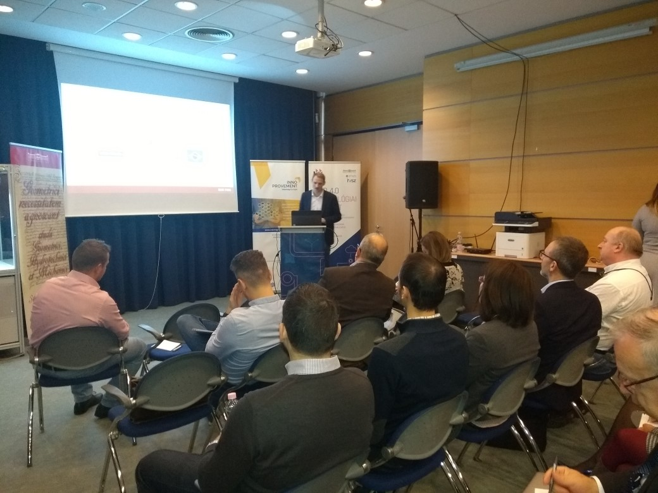
Conclusions
Government has launched a number of programmes to improve digital readiness of SMEs
There are specific initiatives for Industry 4.0
Government backed and non-governmental entities are active in implementing programmes
Specifically in the subject of direct financial assistance there seems to be a need to shift from calls for proposals focusing on equipment purchase to holistic approaches including awareness raising, process reengineering, etc.
Overall, I4.0 policies cover identified needs, it is rather the coordination and co-working of the concerned initiatives and calls that need attention
Conclusions validated by our stakeholder group
3rd stakeholder group meeting
Date: 14 November 2019
Venue: Budapest University of Technology, Industry 4.0 centre

Slide 84
Thank you!
Questions welcome

Slide 85
Regional Overview and Good Practices
„Definition of I4.0 public policy initiatives”
Partner 4: Region of Thessaly
19 November, 2019 3rd Transnational Thematic Meeting, Lisboa

Slide 86
Regional I.4.0 Public Policy Initiatives
General overview of I.4.0 regional public policy initiatives concerning Programming Period 2014-2020
Τitle of the initiative:
ERDF Regional Operation Programme of Thessaly 2014-2020, Priority Axis 1 “Strengthening the competitiveness and extroversion of enterprises (particularly SMEs), transition to qualitative entrepreneurship, spearheaded with the innovation and growth of Regional Value Added“ (https://www.thessalia-espa.gr/)
Research and Innovation Strategy for Smart Specialisation - RIS3 (https://www.thessaly.gov.gr/main.aspx?catid=177)
Summary
During the current programming period, the policy instrument is directly connected with the regional S3 Strategy focusing on the following sectors : agri-food, materials – constructions. So far no relevant calls have been published, even though more than 67 million Euros are planned for this purpose. ICT in its broad sense is a priority in the National S3. In this domain, fields such as “information management technologies” incl. big data, “future internet” incl. advanced cloud and infrastructure services, “Internet of Things” and “Platforms for Connected Smart Objects”, “Robotics”, “Factories of the Future’ are listed that are directly linked to Industry 4.0. Specifically in the Thessaly RIS 3, Industry 4.0 issues are listed under the Cultural and Creative Industries regional priority.
Currently, there is an open call for SMEs entitled “Empowering new, recently founded and under construction companies to exploit patents and / or innovations as well support services to improve their productive activity or to develop new products and services-Invest In Thessaly”, with a total budget of 10 million Euros and a submission deadline of 18th of November 2019. The call focuses on enterprises from the following sectors: agri-food, energy, environment, creative tourism, materials-constructions and health services

Slide 87
Good Practice ESIF
One good practice implemented with ESIF funds (ERDF, ESF)
At a regional level, there is a Good Practice that has been awarded in several occasions within 2019.Cosmos Aluminium SA (https://www.cosmosaluminium.gr/) is one of the most modern, efficient aluminium extrusions in the world and has just recently fully automated its production management in its warehouse, thourgh the development of a fully developed warehouse management system (WMS) that robotically controls the whole process of storage, packaging and shipping of the profiles produced. In order to minimize dead time at the three extrusion lines operating, the company invested in a robotic technology matrices warehouse with a capacity exceeding 6000 matrices and an automatic handling and mounting production. In more detail:
The company fully automated its products mobility, from production up to loading, without human intervention except the supervision of software that manages the whole process.
Using a barcode it is possible to trace and route each of the product shipment throughout the production process
In the closed type warehouse that has company, a fully developed Warehouse Management System (WMS) controls with robots the whole process of profiles storage.
The process of placing the packaged parcels in trucks is also automated as the mounting position is determined by the program by taking into account the quality of the product (figure, length, weight, volume, etc.)

Slide 88
Good Practice ESIF
One good practice implemented with ESIF funds (ERDF, ESF)
The benefits:
Process simplification and better control, thereby reducing it preparation and dispatching order time
Traffic automation and reduction of human intervention by succeeding significant time saving and avoidance of mistakes that were made in the past
The information is available at anyone with access to the system, providing visibility at any time
Benefits from the first day of operation of the project. Depreciation estimation of the whole project is within the next 3 to 4 years
Next steps:
The company's future plans for further automation concern the complete integration of the supply chain. The supply of materials a and b which are used for the production will be done automatically with the registration of customer orders taking into account the required materials as well as stocks available. It is envisaged to develop an EDI link with suppliers for the immediate ordering of raw materials. Also the company aims to utilize Internet of Things technologies through the production process, ie gathering production data (temperature, speeds, sensors at the surface of aluminum profiles, power consumption, etc.), so via analytics can improve its production.

Slide 89
Good Practice General Policy
One good practice implemented/designed in general policy
In May 2019, the Greek Government published its “National Strategy for a Sustainable Development” which includes the actions and funds required for the I 4.0 transformation starting from the programming period of 2021-2027
Regarding the EU Structural Funds, actions under Industry 4.0 era are fully in line with EU policy objectives for the next programming period 2021-2027.
For NSRF 2021-2027, actions related to I 4.0 are directly in line with Policy Objective 1 “A smarter Europe through the promotion of innovative and intelligent economic transformation; Entrepreneurship-Innovation-Connecting to research-smart specialization”. In addition to the NSRF, more financial resources in centralized management programs with competitive EU-wide calls will be available for the 4th Industrial Revolution basically through the following Programs-Funds:
1) Invest EU
2) Horizon
3) Digital Europe
4) Defense Fund, etc.
With regard to the national resources of the Public Investment Programme, the legislative initiatives already undertaken (multiannual programming, linkage with the National Development Strategy, individual strategies and priorities) provide the necessary tools so that significant national resources can be directed to the 4th industrial revolution.

Slide 90
Good Practice General Policy
The actions to be financed could be classified as follows:
A) Investment in infrastructure, mainly in research infrastructures of all kinds in Universities and Research Institutes.
B) Strengthening Digital Innovation Centers, which provide support to businesses to integrate digital technology into their operations. In addition, as part of their activities, they bring together the public and private sectors, the academic and research community to implement larger projects by achieving economies of scale.
C) Strengthening the Support Structures of the Private Sector (Businesses) and the Public Sector for the 4th Industrial Revolution. It also includes the reinforcement of business clusters, Business Angels incubators etc.
D) Supporting Businesses through Grants or Tax Incentives (such as the “Research - Innovate – Create” Programme)
E) Financial Tools for Business Support (Loans, Equity, Venture Capital, Bond Loans, etc.).
F) Any type of training and retraining of unemployed and skilled workers or not in the value chains of the Industry 4.0, funding of studies to investigate the necessary redesign of all levels of education in the light of the changes brought about by digital transformation in society.
The initial steps will include:
Utilizing highly specialized STEM graduates in which the country has the required critical mass of high quality scientists, focusing on areas such as nanotechnology, photonics, biotechnology, manufacturing technologies, advanced materials and information technology (ICT), which influence technologies important for I4.0 and which cross the horizon of the main sectors of the Greek economy.
Develop an appropriate ethical and legal framework for the development and use of technologies that are critical areas within I4.0.
Develop targeted financing programs to exploit the country's advantages at both business and research levels, with an emphasis on supporting networking and synergy between them.

Slide 91
Thank you!
Questions welcome

Slide 92
AGENDA
Welcome COMPETE 2020
Thematic issue: “Definition of I4.0 public policy initiatives”
Launch of Action planning
Joint Analysis Report
Introduction to the next thematic issue
1
2
3
4
5

Slide 93
Action planning kick-off
ICT Association of Hungary
3rd Transnational Thematic Meeting
19 November 2019, Lisbon

Slide 94
The action plan is the most important output for each regular project partner
Programme requirements – basic rules
What is it about?
Each region/country involved in the cooperation project produces an action plan in Phase 1, specifying what will be done in the region in Phase 2 to ensure that the lessons learnt from the cooperation project are put into action.
Definition of the action plan
Action plan is a document providing details on how the lessons learnt from the cooperation will be implemented in order to improve the policy instrument addressed within the partner’s region.
Advisory partners do not write action plan (ICT Association Hungary in our project)
Required content
Nature of the actions to be implemented,
Timeframe of the actions,
Stakeholders involved,
Costs and funding sources,
The way the action derives from the project.
What is the deadline for writing the Action plan?
The action plans have to be submitted to the programme as soon as available, and in any case before the end of phase 1.
Source: Programme Manual (Version 7, 27 March 2019), primarily from page 39

Slide 95
Failing to produce the action plan leads to the recovery of ERDF funding
Programme requirements – basic rules continued
What is the timeframe to implement the actions?
max 2 years (length of Phase 2)
Recommendation is 0.5 – 1.5 years
Dissemination requirement
The final version has to be signed by representative of the policy instrument
The final version has to be published on the project website
Language requirement
The action plan can be in the national language or in English BUT IN ALL CASES:
In order to facilitate the checks carried out at programme level, a comprehensive summary in English highlighting the core features of each action (see annex 1 of the Programme manual) should also be made available to the programme.
This is particularly important for lengthy action plans or in case the action plan is written in a national language other than English.
What if a partner fails to produce an action plan?
Non-production of the action plan leads to the recovery of ERDF
funding from the concerned partner.
Source: Programme Manual (Version 7, 27 March 2019), primarily from page 39

Slide 96
Actions must clearly derive from the project’s international learning
Programme requirements - Recommendations of the Programme manual
1
The action plan template needs to be adapted to the regions’ needs
Design to be adapted
Content to be adapted
But structure is fixed
2
A minimum level of information is required for each action
The Action Plan does not need to be a lengthy document
But all chapters shall be filled in with relevant information
3
Each action should be clearly related to the project
Actions must clearly derive from the project’s learning and in particular from the interregional exchange of experience
That is: which good practice from one of the partner regions or which learning from a project activity inspired the action?
4
Each action needs to be precisely defined, going beyond phase 1 activities
Continuation of the learning is not possible in Phase 2
The action plan specifies how the learning from the project will be transformed into actions
Examples of action plans can be found on line under the various Interreg Europe project’s websites (e.g. ERUDITE, OSIRIS, NICHE, iEER or CLUSTERS3).
Source: Programme Manual (Version 7, 27 March 2019), primarily from page 39

Slide 97
3 types of actions introduced in the Programme manual
Programme requirements - Nature of actions
Type 1
Implementation of new projects
Thanks to interregional cooperation, MAs and other relevant bodies can find inspiration in other regions and import new projects to be financed within their programmes.
Launch of new calls and modification of existing ones belong here, too
This type of impact requires the availability of funding in the programme.
Type 2
Change in the management of the policy instrument (improved governance)
A new methodology for monitoring or evaluating a measure can be developed within the policy instrument
A managing authority or any other relevant body can also improve the way thematic calls are organised or the way projects are selected
It may also refer to the way environmental issues are integrated into the different measures of the operational programmes
Type 3
Change in the strategic focus of the policy instrument (structural change)
It requires a change in the operational programme
Some managing authorities can modify existing measures or even create new measures in their programme
Source: Programme Manual (Version 7, 27 March 2019), page 54

Slide 98
Action plans are implemented in Phase 2
Programme requirements - implementation of the action plan
The implementation of the action plan falls under the responsibility of each partner dealing with the policy instrument
Costs incurred in relation to the implementation of the action cannot be covered from Phase 2 costs – but costs shall be covered from local, regional or national sources
Only the monitoring of the implementation of the action plan is eligible in Phase 2
The action plan is typically not implemented alone by the project partner or it can be that the project partner is not effectively taking part in the action plan implementation (in our project that is not the case – only MAs/IBs in the partnership)
The progress made in implementing the action plan is reported to the programme under phase 2 of the project (via the lead partner) with any necessary explanations if the action plan cannot be partly or fully implemented.
But the non-implementation of an action plan will not call into question the eligibility of costs related to Interreg Europe

Slide 99
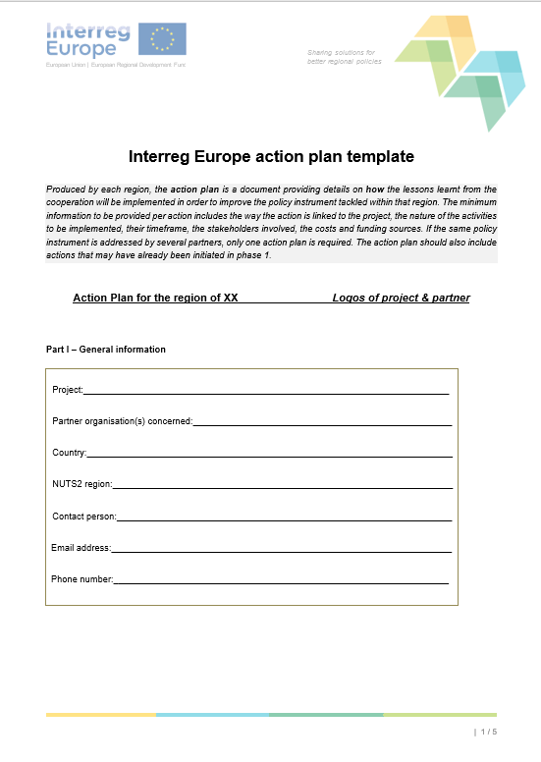
Structure of the action plan template shall be followed
Programme requirements - action plan template
Link of the Action plan template:
https://www.interregeurope.eu/fileadmin/user_upload/documents/Interreg_Europe_action_plan_template.docx
5-page-long English template
Structure:
Part I – General information
Part II – Policy context
Part III – Details of actions envisaged
Action 1
Action 2
Action n
Signature
Source: Programme Manual (Version 7, 27 March 2019), Annex I

Slide 100
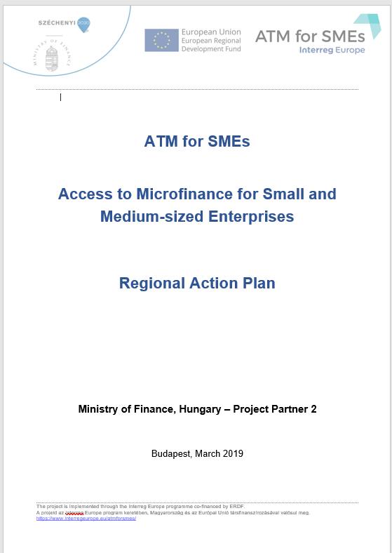
A concrete example
Ministry of Finance, Hungary is a project partner in the ATM for SMEs Interreg Europe project
Phase 1 finished in April 2019, the project is now in Phase 2
The action plan of the Ministry of Finance, Hungary was approved in March 2019
28 page document
Includes 4 actions
Approved by the JS without clarifications
No Hungarian version
Detailed enough for Phase 2 monitoring

Slide 101
Tips for action planning
Number of actions minimum 1 maximum 4. Our recommendation 1-2 feasible actions
„Type 1 - Implementation of new projects” or „Type 2 - Change in the management of the policy instrument (improved governance)” actions are proposed
Try keeping the policy instrument defined in the application form – if that is not possible, it is allowed to change the policy instrument. BUT change it in time! – consult the lead partner and IVSZ first
There can be various actions do not require free OP allocations (see Type 2 actions)
In all cases clear and explicit description and reference shall be made to the good practice that inspired the action
English vs national language – depends on local circumstances
Accelerated action plan writing is possible but the learning from the project has to be clearly demonstrated
Phase 1 final payment will not be transferred by the JS until each action plan in the project is approved by the JS

Slide 102
In INNO PROVEMENT we write 7 action plans
Policy instruments of partners set in the application form
# | Policy Instrument | Project partner | Territorial scope (regional/ national)
1 | Economic Development and Innovation Operational Programme (2014-2020)– ERDF and ESA Fund Priority Axis 2 “Research, Technology development and Innovation” Measure 2.1 “Enhancing R&I activity of research and technology intense enterprises” | Ministry of Finance (HU) | National
2 | Operational Programme Enterprise and Innovation for Competitiveness 2014 2020 Priority Axis 1 “Promotion of research and development for innovation“ Specific Objective 1.1 “Increasing innovation performance of enterprises“ | Ministry of Industry and Trade (CZ) | National
3 | Regional Operation Programme of Thessaly 2014-2020, Priority Axis 1 “Strengthening the competitiveness and extroversion of enterprises (particularly SMEs), transition to qualitative entrepreneurship, spearheaded with the innovation and growth of Regional Value Added“. | Region of Thessaly (GR) | Regional
4 | Regional Operational Programme (ROP) 2014-2020 ERDF Priority Axis 1: Strengthening Research, Technological development and Innovation. Specific Objective 1: Enhancement of the innovatory activity of businesses Action 1.3 Support for the purchase of services for the technological, strategic, organizational and commercial innovation of the companies | Marche Region (IT) | Regional
5 | Portuguese Competitiveness and Internationalization Operational Programme – COMPETE 2020 (2014-2020) Priority Axis 2: “Reinforcement of SME competitiveness and context costs reduction” – ERDF Thematic Objective 3: “Reinforcement of SME competitiveness” Investment Priority 3.3: “SME innovation and qualification” Schemes: Grants with the objective of strengthening SME’s competitiveness through the support of technological (product and process), organisational and marketing innovation projects | COMPETE 2020 Management Authority for the Competitiveness and Internacionality Operational Programme (PT) | National
6 | Regional Operational Programme ERDF 2014-2020 Lodzkie Region (CCI 2014PL16M2OP005) Priority Axis II “An Innovative and competitive economy” Measure II.3 “Increasing the competitiveness of SMEs” Sub - measure II.3.1 “Innovations in SMEs”, Sub - measure II.3.2 “Financial instruments” | Lodzkie Region (PL) | Regional
7 | Sustainable growth and jobs 2014 2020 Finland's structural funds programme', North-East Finland, Kainuu (CCI number: 2014FI16M2OP001). | Regional Council of Kainuu (FI) | Regional

Slide 103
Action plan writing is launched now
Joint Action Planning Methodology for writing the action plans
In the application form we committed to an extended time period for writing the action plans to avoid last minute bottlenecks
We set up pairs so that each partner will have a partner as peer during the action plan development that will serve as a built-in validation function for the Action Plans
Practically, it means that the peers will exchange drafts and discuss developments and outstanding issues regarding their action plans regularly (i. e. in between partnership meetings through calls, skype meetings, etc.).
IVSZ as the advisory partner of the project will provide thematic quality assurance for partners during the development of their action plans and controls the action plan writing process up until the end of Phase 1.

Slide 104
Our methodology
Joint Action Planning Methodology for writing the action plans
Timeline
Action planning
PHASE 1
RP1
RP3
RP5
2018
RP2
2019
RP4
2020
RP6
Calendar month
2021
06
07
08
09
10
11
12
01
02
03
04
05
06
07
08
09
10
11
12
01
02
03
04
05
06
07
08
09
10
11
12
01
02
03
04
05
Project month
01
02
03
04
05
06
07
08
09
10
11
12
13
14
15
16
17
18
19
20
21
22
23
24
25
26
27
28
29
30
31
32
33
34
35
36
Event types
LSG
LSG
LSG
LSG
LSG
LSG
Kick- off
SC
WG
TTM3
WG
TTM4
WG
TTM5
SC
WG
TTM6
SC
WG
RAPWS
SC
WG
TTM1
SC
WG
TTM2
WG
TTM3
SC
WG
Location
Host
HU
MNE
CZ
MIT
FI
RCK
PT
COMPETE
PL
Lodzkie
HU
MNE
IT
Marche
GR
ROT
HU
ICTH
Methodological issues to be cleared by Lodz TTM (meeting in PL – February 2020, project month 21)
Drafting of Action plan from February 2020 (project month 21) until February 2021 (project month 33)
Final quality check of action plans by IVSZ in December 2020 – February 2021 (project month 31-33)
Our last transnational meeting in Phase 1 is the Regional Action Plan Workshop organised by IVSZ in HU in February 2021 (project month 33). The meeting will dedicated fully to finalising the action plans
Action plans to be completed by March 2021 (project month 34)

Slide 105
Current issues
Joint Action Planning Methodology for writing the action plans
Current issues – first points to consider and decide until next TTM
Change of policy instrument?
Based on experience from the project so far, consider thoroughly if you will be able to make the action plan on the policy instrument you named in the application form or you want to change
If you want to change, notify the LP and IVSZ early
Document format
Consider thoroughly if you want to elaborate an action plan document beyond the Interreg Europe template or you stick to the template
The filled in Interreg Europe template size should not exceed 30-40 pages at max depending on the number of actions
Language
English AND/OR National language
Don't forget: there should be one concise English version in the Interreg Europe template
Collection of good practices
Collection of good practices from thematic issues 1-3 is an urging task:
Issue 1: The Effectiveness of Public Money Used to Support Industrial Research and Development under the I4.0
Issue 2: Introducing I4.0 to traditional industries
Issue 3: Definition of I4.0 public policy initiatives
Setting up pairs
Proposal (subject to agreement from all partners):
Group 1: Kainuu (FI) – MIT (CZ)
Group 2: Compete 2020 (PT) – Lodzkie (PL)
Group 3: Thessaly (GR), Marche (IT), MoF (HU)

Slide 106
Thank you!

Slide 107
AGENDA
Welcome COMPETE 2020
Thematic issue: “Definition of I4.0 public policy initiatives”
Launch of Action planning
Joint Analysis Report
Introduction to the next thematic issue
1
2
3
4
5

Slide 108
Introduction to the next International Meeting in Łódź „Definition of an Industry 4.0. maturity evaluation matrix for projects”
Michał Mikina
Lodzkie Region
19 November 2019, Lisbon

Slide 109
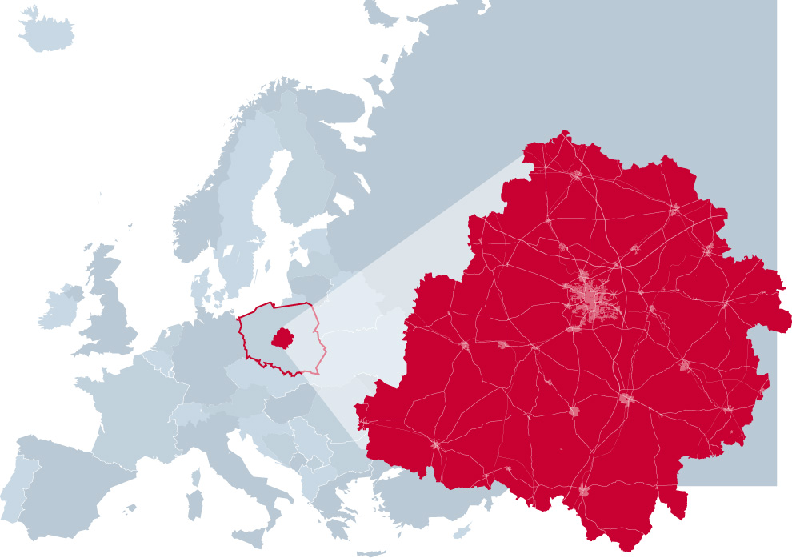
Proposed dates and duration
The meeting is going to last 2 full days.
The proposed date is:
24 – 27 March 2020 (meeting 25-26 March)
Location: Łódź, Lodzkie Region, Poland
Questions and help in reaching Łódź:
Katarzyna Kurniawka, Michał Mikina
katarzyna.kurniawka@lodzkie.pl
michal.mikina@lodzkie.pl

Slide 110
Agenda, thematic issue – for discussion
First day of the meeting:
introduction into the Definition of an Industry 4.0. maturity evaluation matrix for projects by the respresentative of Polish “Industry of the Future” Platform Foundation which is an expert and “national integrator responsible for bringing the national industry transformation to the level defined as Industry 4.0”
Presenting the Industry 4.0 maturity model in Poland
Presenting by the Partners the research on the subject made on regional and national level in their countries. It helps to work out the optimal tool, which Lodzkie Region as a regional authority could propose as a content of policy instrument.
Workshops supervised by the experts , disscusion,
Second day:
Study visits in the technological companies and Lodz University of Technology
Steering committee meeting

Slide 111
Agenda, thematic issue – for discussion
Improving policy instruments in the scope of the Industry 4.0 maturity evaluation matrix is crucial in successful applying for the grants and implementing Industry 4.0 related innovation projects.
Industry 4.0 maturity is a multidimensional concept that requires development in many areas like:
technological resources and technological cooperation,
the ways of management,
organizational culture and human capital
changing the perception of the role of the company in creating a value chain
Industry 4.0 maturity evaluation matrix should contain above aspects.
Polish Ministry of Entrepreneurship and Technology in cooperation with Digital Economy Lab of the University of Warsaw created the tool, which we would like to based on - Industry 4.0 maturity model.

Slide 112
Industry 4.0. maturity evaluation
The Industry 4.0 maturity model consists of 3 basic modules that are crucial for the development of I. 4.0 in production companies. These are:
Organisational
Technological
Process
Companies should consider all 3 areas in order to fully exploit the potential of Industry 4.0.
The pillars are based on 12 key modules representing the critical aspects on which companies should focus on (on the next slide).
The model methodology and 6 maturity levels enables to create the detailed maturity assessment with a description of the maturity level achieved by the respondent and the presentation of recommendations for further actions.
The tool is currently being tested on the Polish market and evaluation works are in progress to develop a list of recommendations.

Slide 113
Industry 4.0. maturity evaluation
Organization
Technologies
Processes
1. Cooperation and projects
2. Strategy
3. Employees
4. Leadership
5. Intelligent product
1. Autonomy
2. Automation
3.Communication
1. Internal integration
2. Integration of the
life cycle assessment
3. Integration into the environment
4. Standardisation

Slide 114
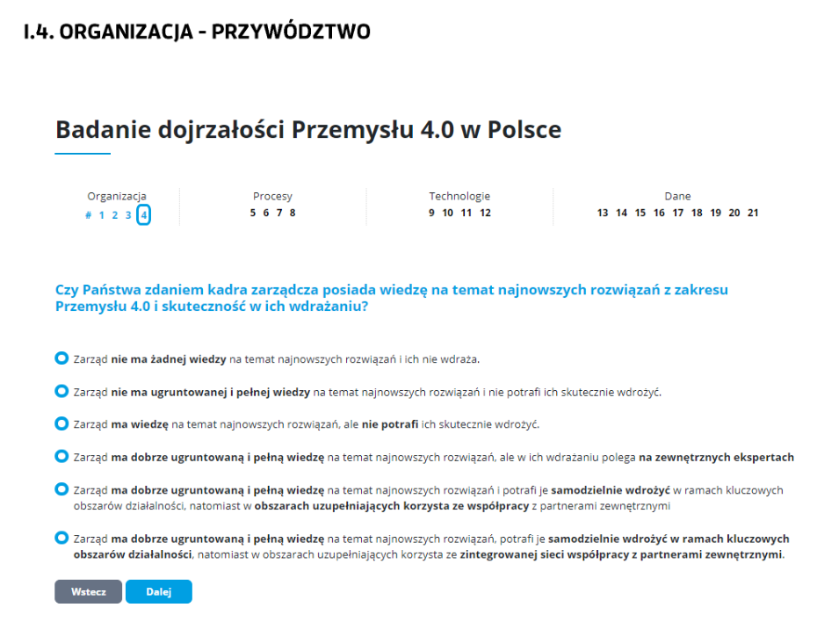
ORGANISATION – LEADERSHIP
Evaluation of Industry 4.0 maturity in Poland
Organization
Processes
Technologies
Company data
Whether in your opinion the management is aware of the latest solutions in Industry 4.0 area and is effective in their implementation
The management has no knowledge of the latest solutions and does not implement them
The Management Board does not have an established and full knowledge of the latest solutions and is not able to implement them effectively.
The Management Board has knowledge of the latest solutions, but is not able to implement them effectively
The Management Board has a well-established and full knowledge of the latest solutions, but relies on external experts when implementing them
The Management Board has a well-established and full knowledge of the latest solutions, it is able to implement them independently within the key areas of activity, while in the complementary areas it uses cooperation with external partners.
The Management Board has a well-established and full knowledge of the latest solutions, is able to implement them independently in key business areas, and in complementary areas, uses an integrated network of cooperation with external partners.
Back
Forward

Slide 115
Thank you!

Slide 116
Agenda, thematic issue – for discussion
Mature organizations are characterized by:
- the ability to introduce new business models,
- customer-centric approach,
- flexible adaptation to changing market trends.
These are the factors which are required while implementing Industry 4.0 idea.
Taking all above into account while creating the policy instruments it is necessary to support SMEs with introducing the Industry 4.0 maturity evaluation matrix.
Polish Ministry of Entrepreneurship and Technology has initiated creation of similar kind of tool called the self-assessment tool for digital maturity.
Its role (by mapping of resources and company's needs in order to achieve full possibilities of using the solutions of the Industry 4.0.) is to:
- educate about the changes that should be done as a part of building their digitization strategies
- estimate their readiness to implement Industry 4.0.
- present the initial diagnosis
- inform which of company's activities should be improve

