Slide 1
Regional Overview and Good Practices
„Definition of I4.0 public policy initiatives”
Ministry of Finance, Hungary
19 November, 2019 3rd Transnational Thematic Meeting, Lisboa

Slide 2
I.4.0 Public Policy Initiatives in Hungary
  Strategies, platforms, umbrella programmes
1
Irinyi Plan – February 2016
  Industry strategy of the Hungarian Government
  Author: Ministry for National Economy
  Objective of the strategy: Industrial production in GDP to reach 30% by 2020
  Forerunner to subsequent Industry 4.0 programmes and strategies
  Five pillars of Irinyi Plan
Utilisation of new and digital technologies
Dissolving territorial inequalities
Promotion of material efficient manufacturing
Energy and raw material efficiency
Support to branches using energy in low demand periods
Source: Inno Provement Regional assessment on EDIOP Priority Axis 2 – Ministry of Finance

Slide 3
I.4.0 Public Policy Initiatives in Hungary
  Strategies, platforms, umbrella programmes
2
Industry 4.0 National Technology Platform
  Initiated in May 2016 by the Ministry for National Economy
  Set up by 40 entities including companies, research institutes, universities and business support organisations from Hungary
  Number of participants now exceeds 100
  Main objective:
    the promotion of Industry 4.0 developments,
    knowledge sharing in the domain of Industry 4.0,
    professional consultancy and counselling for the Hungarian government and for actors of the Industry 4.0 ecosystem
  Works in 7 working groups
  7 working groups of the Industry 4.0 National Technology Platform
Strategic planning
Infocommunication technologies
Employment, education and training
Industry 4.0 experimental demo systems
Defining legal framework
Manufacturing and logistics
Innovation and business model
Source: Inno Provement Regional assessment on EDIOP Priority Axis 2 – Ministry of Finance

Slide 4
Good practice general policy I4.0
  Strategies, platforms, umbrella programmes
3
Digital Welfare Programme and Digital Welfare Programme 2.0
  A collection of development programmes for the digitalisation of Hungary
  Aim: advancing Hungary among the top 10 countries in the EU by the early 2020s
Digital access
Strategies
Digital tax reduction
Digital Welfare Basic Package
Digital Welfare WiFi
Digital networks
Digital Education Strategy
Digital Startup Strategy
Digital Export Promotion Strategy
Digital Children Protection Strategy
Strategy Study on Digital Welfare Programme 2.0
Digitalisation Strategy of Public Collections
Superfast Internet Programme
Hungarian 5G Coalition
National Information Infrastructure Development Programme
National Telecommunication Backbone Network
Mobile internet Network Development
Digital state
Digital knowledge
Digital security
Smart city
Digital public administration
Digital economy
Digital Knowledge Development
Digital Welfare Programme Network
Smart Kindergarten Programme
Industry 4.0
Digital Workforce Programme
Digital Health Industry Development Strategy
Digital Agri Strategy
Digital Welfare Credit Programme
Artificial Intelligence Coalition
Source: Inno Provement Regional assessment on EDIOP Priority Axis 2 – Ministry of Finance

Slide 5
I.4.0 Public Policy Initiatives in Hungary
  Strategies, platforms, umbrella programmes
4
Vocational training 4.0
  Strategy of reforming vocational training and adult education with regards to challenges of Industry 4.0
  Strategy of the Innovation and Technology Ministry from March 2019
  Industry 4.0 changes professions and requirements of employers, therefore changes are needed in vocational training and adult educations
  New structure of vocational training (secondary school system)
  Reinforcing dual training
  Infrastructure development for school workshops
  Teachers receiving specialised trainings at companies

Slide 6
I.4.0 Public Policy Initiatives in Hungary
  Coherence of I4.0 public policy initiatives – analysis framework
  Awareness
  Readiness
  Execution
Campaigns
Demonstrations
Events
….
Management
Production technologies
Skills development
….
Planning
Funding
Building
Testing
….
  Commitment
  Strategy
  Change
Source: Balázs Tordai, ICT Association Hungary

Slide 7
I.4.0 Public Policy Initiatives in Hungary
  Coherence of I4.0 public policy initiatives – analysis framework
  Awareness
  Readiness
  Execution
Industry 4.0 National Technology Platform
Campaigns
Demonstrations
Events
….
Management
Production technologies
Skills development
….
Planning
Funding
Building
Testing
….
  Commitment
  Strategy
  Change

Slide 8
I.4.0 Public Policy Initiatives in Hungary
  Coherence of I4.0 public policy initiatives – analysis framework
Open calls in EDIOP Priority Axis 1 – SME development
  Awareness
  Readiness
  Execution
Industry 4.0 National Technology Platform
EDIOP-1.1.3 (Industry 4.0/ Modern model factory)
Campaigns
Demonstrations
Events
….
Management
Production technologies
Skills development
….
Planning
Funding
Building
Testing
….
EDIOP-1.2.8 (Open call for SMEs on I4.0)
  Commitment
  Strategy
  Change
EDIOP-1.1.4 - Programme for Medium-Sized Companies/”Hungarian Multinationals”

Slide 9
I.4.0 Public Policy Initiatives in Hungary
  Coherence of I4.0 public policy initiatives – analysis framework
Open calls in EDIOP Priority Axis 3 – ICT
  Awareness
  Readiness
  Execution
Industry 4.0 National Technology Platform
EDIOP-1.1.3 (Industry 4.0/ Modern model factory)
Campaigns
Demonstrations
Events
….
Management
Production technologies
Skills development
….
Planning
Funding
Building
Testing
….
EDIOP-1.2.8 (Open call for SMEs on I4.0)
EDIOP-3.2.2 (Open call for SMEs on ICT, ERP developments)
EDIOP-3.2.6 (Open call for SMEs on advanced digitalisation)
EDIOP-3.2.1 (Modern Enterprises)
  Commitment
  Strategy
  Change
EDIOP-1.1.4 - Programme for Medium-Sized Companies/”Hungarian Multinationals”
EDIOP-3.2.4 (Open call for SMEs on cloud based developments)

Slide 10
I.4.0 Public Policy Initiatives in Hungary
  Coherence of I4.0 public policy initiatives – analysis framework
Open calls in EDIOP Priority Axis 6 – Training
  Awareness
  Readiness
  Execution
Industry 4.0 National Technology Platform
EDIOP-1.1.3 (Industry 4.0/ Modern model factory)
Campaigns
Demonstrations
Events
….
Management
Production technologies
Skills development
….
Planning
Funding
Building
Testing
….
EDIOP-1.2.8 (Open call for SMEs on I4.0)
EDIOP-6.1.10 (Innovative trainings for SMEs in the field of I4.0)
EDIOP-3.2.2 (Open call for SMEs on ICT, ERP developments)
EDIOP-3.2.6 (Open call for SMEs on advanced digitalisation)
EDIOP-3.2.1 (Modern Enterprises)
  Commitment
  Strategy
  Change
EDIOP-1.1.4 - Programme for Medium-Sized Companies/”Hungarian Multinationals”
EDIOP-3.2.4 (Open call for SMEs on cloud based developments)
EDIOP-6.1.6 (Open call for on-the-job trainings)

Slide 11
Good practice ESIF
  Projects
Priority projects in EDIOP Priority Axis 1 – SME development
Industry 4.0/Modern model factory - priority project under EDIOP (EDIOP-1.1.3)
  Total project volume ~ EUR 15 million (original project volume EUR 7 million)
  Beneficiary: Consortium of IFKA Nonprofit Ltd (state-owned company involved in the implementation of a number of EDIOP projects) and ICT Association of Hungary
  Implementation period: 13.06.2017 – 15.09.2021
  Various awarenesss raising activities
  Industry 4.0 maturity assessment for SMEs
  Industry 4.0 demonstration factories
  Industry 4.0 Technology Centre
  Customised consultancy, training and business planning for SMEs
  Project currently under transformation: less Industry 4.0 and more digitalisation for increased number of private entrepreneurs and micro enterprises

Slide 12
I.4.0 Public Policy Initiatives in Hungary
  Projects
Priority projects in EDIOP Priority Axis 1 – SME development
Programme for High-Growth Medium-Sized Companies – priority project under EDIOP (EDIOP-1.1.4)
  Total project volume ~ Eur 6.6 million
  Beneficiary: IFKA Nonprofit Ltd (state-owned company involved in the implementation of a number of EDIOP projects)
  Implementation period: 15/06/2017 - 2020
  Complex support high-growth companies including mapping, training and mentoring
  Mentoring and training included Industry 4.0 issues

Slide 13
I.4.0 Public Policy Initiatives in Hungary
  Projects
Open calls in EDIOP Priority Axis 1 – SME development
Open call for the development of SMEs for industrial digitalization (Industry 4.0) (EDIOP-1.2.8)
  Eligible applicants: small- and medium sized companies in convergence regions with at least 20 employees and at least 0.63 m EUR annual revenue
  Total budget of the call: 20.5 m EUR
  Budget per project: 67 000 EUR – 1.7 m EUR;
  Intensity rate: max. 50% (depending on the region)
  Supported activities in a project:
    Purchasing new machineries
    Developing automatic production system,
    Development of production technologies: process automation tools, development of sensor and control technologies using robotics
    Industrial cyber solutions, smart manufacturing, machine-to-machine, purchasing IoT solutions
    Licence, know-how, immaterial goods
  Call open was open in 2017
  15 projects were approved in a total grant volume of EUR 10.4 million

Slide 14
I.4.0 Public Policy Initiatives in Hungary
  Projects
Priority projects and open calls in EDIOP Priority Axis 3 - ICT
Programme for Modern Businesses – priority project under EDIOP (EDIOP-3.2.1)
  Complex support for SMEs for their digital transformation
Open call for SMEs on advanced digitalisation in Industry 4.0 and IoT (EDIOP-3.2.6)
  Eligible applicants: micro-, small- and medium sized companies in convergence regions
  Call open was open in 2017 for 10 months
  Grant + preferential loan
  17 projects were approved in a total grant volume of EUR 3.2 million
Open call for SMEs on ICT, ERP developments, cloud based online business services (EDIOP-3.2.2)
  Eligible applicants: micro-, small- and medium sized companies in convergence regions
  Call open since December 2016
  Grant + preferential loan
  Max project size EUR 220,000; grant ratio max 40%. Min 10% own source needed and loan must exceed grant
  Up until now 907 approved projects with total non-refundable grant volume of EUR 26 million
Open call for SMEs on cloud based developments (EDIOP-3.2.4)
  Targets those companies that would like set up cloud based service centres with IaaS, PaaS, SaaS services to SMEs
  Eligible applicants: micro-, small- and medium sized companies in convergence regions
  Call open between December 2016 – March 2019
  Grant + preferential loan
  Up until now 15 approved projects with total non-refundable grant volume of EUR 4.2 million

Slide 15
I.4.0 Public Policy Initiatives in Hungary
  Projects
Project under in EDIOP Priority Axis 6 – Training (ESF)
Innovative trainings for SMEs related to Industry 4.0 under EDIOP (EDIOP-6.1.10)
  New project starting from 2020
  Total project volume: EUR 21.2 million
  Beneficiary: Consortium of Innovative Training Centre (leader) and 9 regional vocational training centres
  Theoretical and practical Industry 4.0 trainings for students and SME employees
Open call for SMEs for on-the-job trainings (EDIOP-6.1.6)
  Eligible applicants: micro-, small- and medium sized companies in convergence regions
  Total financial envelope: EUR 40 million
  Horizontal on-the-job training call including the possibility for providing Industry 4.0 related trainings (preferential treatment at project selection – plus 8 points in a 100-point scheme)
  70% of 1200 SMEs chose to include Industry 4.0 related trainings in their training plans

Slide 16
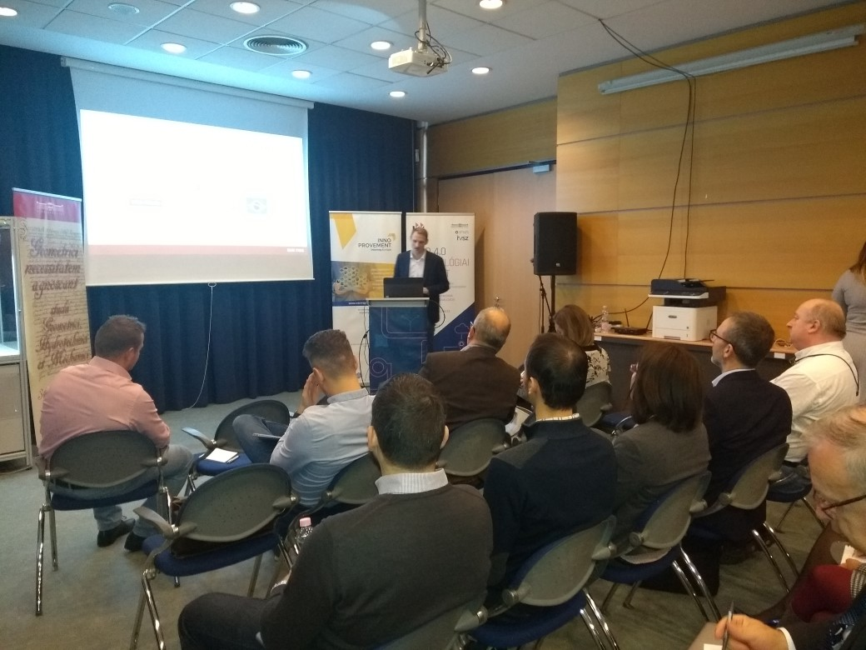
Conclusions
Government has launched a number of programmes to improve digital readiness of SMEs
There are specific initiatives for Industry 4.0
Government backed and non-governmental entities are active in implementing programmes
Specifically in the subject of direct financial assistance there seems to be a need to shift from calls for proposals focusing on equipment purchase to holistic approaches including awareness raising, process reengineering, etc.
Overall, I4.0 policies cover identified needs, it is rather the coordination and co-working of the concerned initiatives and calls that need attention
Conclusions validated by our stakeholder group
3rd stakeholder group meeting
Date: 14 November 2019
Venue: Budapest University of Technology, Industry 4.0 centre

Slide 17
Thank you!
Questions welcome

