Slide 1
Action planning kick-off
ICT Association of Hungary
3rd Transnational Thematic Meeting
19 November 2019, Lisbon

Slide 2
The action plan is the most important output for each regular project partner
  Programme requirements – basic rules
  What is it about?
  Each region/country involved in the cooperation project produces an action plan in Phase 1, specifying what will be done in the region in Phase 2 to ensure that the lessons learnt from the cooperation project are put into action.
  Definition of the action plan
  Action plan is a document providing details on how the lessons learnt from the cooperation will be implemented in order to improve the policy instrument addressed within the partner’s region.
  Advisory partners do not write action plan (ICT Association Hungary in our project)
  Required content
  Nature of the actions to be implemented,
  Timeframe of the actions,
  Stakeholders involved,
  Costs and funding sources,
  The way the action derives from the project.
  What is the deadline for writing the Action plan?
  The action plans have to be submitted to the programme as soon as available, and in any case before the end of phase 1.
  Source: Programme Manual (Version 7, 27 March 2019), primarily from page 39

Slide 3
Failing to produce the action plan leads to the recovery of ERDF funding
  Programme requirements – basic rules continued
  What is the timeframe to implement the actions?
  max 2 years (length of Phase 2)
  Recommendation is 0.5 – 1.5 years
  Dissemination requirement
  The final version has to be signed by representative of the policy instrument
  The final version has to be published on the project website
  Language requirement
  The action plan can be in the national language or in English BUT IN ALL CASES:
  In order to facilitate the checks carried out at programme level, a comprehensive summary in English highlighting the core features of each action (see annex 1 of the Programme manual) should also be made available to the programme.
  This is particularly important for lengthy action plans or in case the action plan is written in a national language other than English.
  What if a partner fails to produce an action plan?
  Non-production of the action plan leads to the recovery of ERDF
  funding from the concerned partner.
  Source: Programme Manual (Version 7, 27 March 2019), primarily from page 39

Slide 4
Actions must clearly derive from the project’s international learning
  Programme requirements - Recommendations of the Programme manual
  1
  The action plan template needs to be adapted to the regions’ needs
  Design to be adapted
  Content to be adapted
  But structure is fixed
  2
  A minimum level of information is required for each action
  The Action Plan does not need to be a lengthy document
  But all chapters shall be filled in with relevant information
  3
  Each action should be clearly related to the project
  Actions must clearly derive from the project’s learning and in particular from the interregional exchange of experience
  That is: which good practice from one of the partner regions or which learning from a project activity inspired the action?
  4
  Each action needs to be precisely defined, going beyond phase 1 activities
  Continuation of the learning is not possible in Phase 2
  The action plan specifies how the learning from the project will be transformed into actions
  Examples of action plans can be found on line under the various Interreg Europe project’s websites (e.g. ERUDITE, OSIRIS, NICHE, iEER or CLUSTERS3).
  Source: Programme Manual (Version 7, 27 March 2019), primarily from page 39

Slide 5
3 types of actions introduced in the Programme manual
  Programme requirements - Nature of actions
  Type 1
  Implementation of new projects
  Thanks to interregional cooperation, MAs and other relevant bodies can find inspiration in other regions and import new projects to be financed within their programmes.
  Launch of new calls and modification of existing ones belong here, too
  This type of impact requires the availability of funding in the programme.
  Type 2
  Change in the management of the policy instrument (improved governance)
  A new methodology for monitoring or evaluating a measure can be developed within the policy instrument
  A managing authority or any other relevant body can also improve the way thematic calls are organised or the way projects are selected
  It may also refer to the way environmental issues are integrated into the different measures of the operational programmes
  Type 3
  Change in the strategic focus of the policy instrument (structural change)
  It requires a change in the operational programme
  Some managing authorities can modify existing measures or even create new measures in their programme
  Source: Programme Manual (Version 7, 27 March 2019), page 54

Slide 6
Action plans are implemented in Phase 2
  Programme requirements - implementation of the action plan
  The implementation of the action plan falls under the responsibility of each partner dealing with the policy instrument
  Costs incurred in relation to the implementation of the action cannot be covered from Phase 2 costs – but costs shall be covered from local, regional or national sources
  Only the monitoring of the implementation of the action plan is eligible in Phase 2
  The action plan is typically not implemented alone by the project partner or it can be that the project partner is not effectively taking part in the action plan implementation (in our project that is not the case – only MAs/IBs in the partnership)
  The progress made in implementing the action plan is reported to the programme under phase 2 of the project (via the lead partner) with any necessary explanations if the action plan cannot be partly or fully implemented.
  But the non-implementation of an action plan will not call into question the eligibility of costs related to Interreg Europe

Slide 7
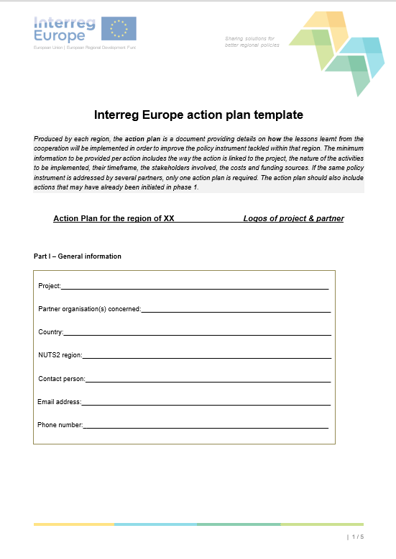
Structure of the action plan template shall be followed
  Programme requirements - action plan template
  Link of the Action plan template:
  https://www.interregeurope.eu/fileadmin/user_upload/documents/Interreg_Europe_action_plan_template.docx
  5-page-long English template
  Structure:
    Part I – General information
    Part II – Policy context
    Part III – Details of actions envisaged
      Action 1
      Action 2
      Action n
    Signature
  Source: Programme Manual (Version 7, 27 March 2019), Annex I

Slide 8

A concrete example
  Ministry of Finance, Hungary is a project partner in the ATM for SMEs Interreg Europe project
  Phase 1 finished in April 2019, the project is now in Phase 2
  The action plan of the Ministry of Finance, Hungary was approved in March 2019
  28 page document
  Includes 4 actions
  Approved by the JS without clarifications
  No Hungarian version
  Detailed enough for Phase 2 monitoring

Slide 9
Tips for action planning
  Number of actions minimum 1 maximum 4. Our recommendation 1-2 feasible actions
  „Type 1 - Implementation of new projects” or „Type 2 - Change in the management of the policy instrument (improved governance)” actions are proposed
  Try keeping the policy instrument defined in the application form – if that is not possible, it is allowed to change the policy instrument. BUT change it in time! – consult the lead partner and IVSZ first
  There can be various actions do not require free OP allocations (see Type 2 actions)
  In all cases clear and explicit description and reference shall be made to the good practice that inspired the action
  English vs national language – depends on local circumstances
  Accelerated action plan writing is possible but the learning from the project has to be clearly demonstrated
  Phase 1 final payment will not be transferred by the JS until each action plan in the project is approved by the JS

Slide 10
In INNO PROVEMENT we write 7 action plans
  Policy instruments of partners set in the application form
# | Policy Instrument | Project partner | Territorial scope (regional/ national)
1 | Economic Development and Innovation Operational Programme (2014-2020)– ERDF and ESA Fund Priority Axis 2 “Research, Technology development and Innovation” Measure 2.1 “Enhancing R&I activity of research and technology intense enterprises” | Ministry of Finance (HU) | National
2 | Operational Programme Enterprise and Innovation for Competitiveness 2014 2020 Priority Axis 1 “Promotion of research and development for innovation“ Specific Objective 1.1 “Increasing innovation performance of enterprises“ | Ministry of Industry and Trade (CZ) | National
3 | Regional Operation Programme of Thessaly 2014-2020, Priority Axis 1 “Strengthening the competitiveness and extroversion of enterprises (particularly SMEs), transition to qualitative entrepreneurship, spearheaded with the innovation and growth of Regional Value Added“. | Region of Thessaly (GR) | Regional
4 | Regional Operational Programme (ROP) 2014-2020 ERDF Priority Axis 1: Strengthening Research, Technological development and Innovation. Specific Objective 1: Enhancement of the innovatory activity of businesses Action 1.3 Support for the purchase of services for the technological, strategic, organizational and commercial innovation of the companies | Marche Region (IT) | Regional
5 | Portuguese Competitiveness and Internationalization Operational Programme – COMPETE 2020 (2014-2020) Priority Axis 2: “Reinforcement of SME competitiveness and context costs reduction” – ERDF Thematic Objective 3: “Reinforcement of SME competitiveness” Investment Priority 3.3: “SME innovation and qualification” Schemes: Grants with the objective of strengthening SME’s competitiveness through the support of technological (product and process), organisational and marketing innovation projects | COMPETE 2020 Management Authority for the Competitiveness and Internacionality Operational Programme (PT) | National
6 | Regional Operational Programme ERDF 2014-2020 Lodzkie Region (CCI 2014PL16M2OP005) Priority Axis II “An Innovative and competitive economy” Measure II.3 “Increasing the competitiveness of SMEs” Sub - measure II.3.1 “Innovations in SMEs”, Sub - measure II.3.2 “Financial instruments” | Lodzkie Region (PL) | Regional
7 | Sustainable growth and jobs 2014 2020 Finland's structural funds programme', North-East Finland, Kainuu (CCI number: 2014FI16M2OP001). | Regional Council of Kainuu (FI) | Regional

Slide 11
Action plan writing is launched now
  Joint Action Planning Methodology for writing the action plans
  In the application form we committed to an extended time period for writing the action plans to avoid last minute bottlenecks
  We set up pairs so that each partner will have a partner as peer during the action plan development that will serve as a built-in validation function for the Action Plans
  Practically, it means that the peers will exchange drafts and discuss developments and outstanding issues regarding their action plans regularly (i. e. in between partnership meetings through calls, skype meetings, etc.).
  IVSZ as the advisory partner of the project will provide thematic quality assurance for partners during the development of their action plans and controls the action plan writing process up until the end of Phase 1.

Slide 12
Our methodology
  Joint Action Planning Methodology for writing the action plans
Timeline
Action planning
PHASE 1
RP1
RP3
RP5
2018
RP2
2019
RP4
2020
RP6
Calendar month
2021
06
07
08
09
10
11
12
01
02
03
04
05
06
07
08
09
10
11
12
01
02
03
04
05
06
07
08
09
10
11
12
01
02
03
04
05
Project month
01
02
03
04
05
06
07
08
09
10
11
12
13
14
15
16
17
18
19
20
21
22
23
24
25
26
27
28
29
30
31
32
33
34
35
36
Event types
LSG
LSG
LSG
LSG
LSG
LSG
Kick- off
SC
WG
TTM3
WG
TTM4
WG
TTM5
SC
WG
TTM6
SC
WG
RAPWS
SC
WG
TTM1
SC
WG
TTM2
WG
TTM3
SC
WG
Location
Host
HU
MNE
CZ
MIT
FI
RCK
PT
COMPETE
PL
Lodzkie
HU
MNE
IT
Marche
GR
ROT
HU
ICTH
  Methodological issues to be cleared by Lodz TTM (meeting in PL – February 2020, project month 21)
  Drafting of Action plan from February 2020 (project month 21) until February 2021 (project month 33)
  Final quality check of action plans by IVSZ in December 2020 – February 2021 (project month 31-33)
  Our last transnational meeting in Phase 1 is the Regional Action Plan Workshop organised by IVSZ in HU in February 2021 (project month 33). The meeting will dedicated fully to finalising the action plans
  Action plans to be completed by March 2021 (project month 34)

Slide 13
Current issues
  Joint Action Planning Methodology for writing the action plans
Current issues – first points to consider and decide until next TTM
Change of policy instrument?
  Based on experience from the project so far, consider thoroughly if you will be able to make the action plan on the policy instrument you named in the application form or you want to change
  If you want to change, notify the LP and IVSZ early
Document format
  Consider thoroughly if you want to elaborate an action plan document beyond the Interreg Europe template or you stick to the template
  The filled in Interreg Europe template size should not exceed 30-40 pages at max depending on the number of actions
Language
  English AND/OR National language
  Don't forget: there should be one concise English version in the Interreg Europe template
Collection of good practices
  Collection of good practices from thematic issues 1-3 is an urging task:
    Issue 1: The Effectiveness of Public Money Used to Support Industrial Research and Development under the I4.0
    Issue 2: Introducing I4.0 to traditional industries
    Issue 3: Definition of I4.0 public policy initiatives
Setting up pairs
  Proposal (subject to agreement from all partners):
    Group 1: Kainuu (FI) – MIT (CZ)
    Group 2: Compete 2020 (PT) – Lodzkie (PL)
    Group 3: Thessaly (GR), Marche (IT), MoF (HU)

Slide 14
Thank you!

