Slide 1
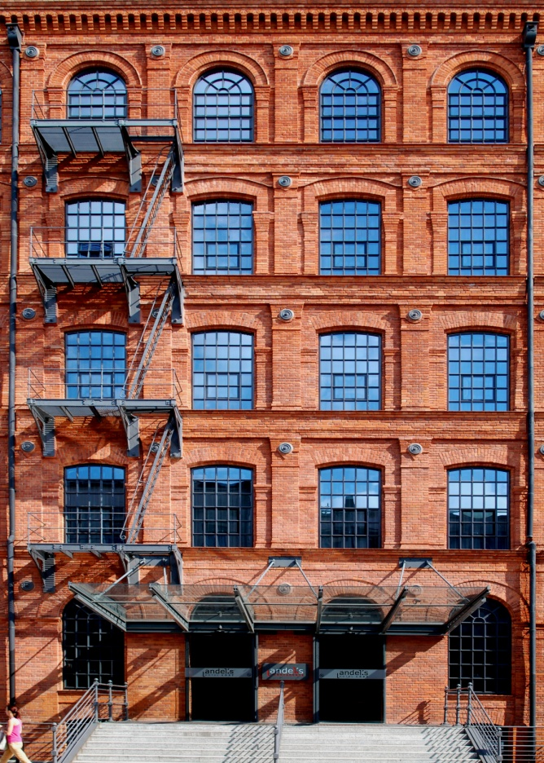

XVI International Biodeterioration and Biodegradation Symposium
September 3-5, 2014
LODZ, POLAND
Microbiologically Influenced Corrosion
Biofilms and Biofouling
Biodeterioration and Biodegradation of Wood and Wood Products
Biodeterioration and Biodegradation of Polymeric Materials
Biodeterioration of Cultural Heritage
Microorganisms and the Quality of Life
Biotransformation and Biodegradation of Hazardous Compounds
Biodegradation and Bioremediation of Persistent Pollutants
Biodiversity of Organisms involved in Biodeterioration, Biodegradation and Bioremediation
Strategic views of Economic, Regulatory Affairs, Forensic Studies and Regional Development in Biodeterioration
Protection against Biodeterioration Process
Bioremediation in Environmental Protection
XIXth century building of Izrael Poznański Palace
Phot. Włodzimierz Adamiak

Slide 2




XVI International Biodeterioration and Biodegradation Symposium
September 3-5, 2014
ŁÓDŹ, POLAND
Registration deadlines:
February 28th 2014: Early registration
April 30th 2014: Regular registration
June 30th 2014: Late registration
www.ibbs2014.p.lodz.pl
IBBS2014@info.p.lodz.pl
Created by Elżbieta Klewicka and Agnieszka Tyfa

