Slide 1


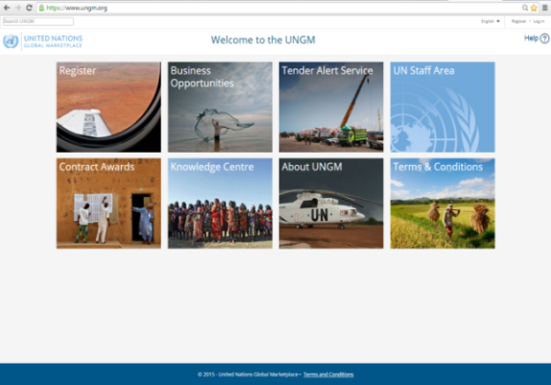
UN Global Marketplace
Vendor registration
by
Susan Rendtorff
UNGM Secretariat

Slide 2








Agenda
About UNGM
Polish suppliers in UNGM
Registration process on www.ungm.org
Finding business opportunities
More information – Knowledge Centre
Where to find help
United Nations Global Marketplace – www.ungm.org

Slide 3







2
UNGM – UN Global Marketplace
UNGM is the procurement portal of the UN system
Vendor community
UN procurement staff
UNGM provides and excellent springboard to introduce your products and services to many UN organizations, countries and regions
United Nations Global Marketplace – www.ungm.org

Slide 4











1
UNGM – UN Global Marketplace
Vendors can register with 26 UN organizations
using UNGM as their vendor database
  These UN organizations represent 99% of a global spend of over
  $17.6 billion in 2015
United Nations Global Marketplace – www.ungm.org

Slide 5

2
Polish suppliers on UNGM
167th largest supplier to UN in 2015 – 68 suppliers
414 accounts
291 with one or more registered
status with one or more UN agency
65 with a Vendor to Update status
5 TAS subscribers
  Please contact me.
  I would love to help!
  registry@ungm.org

Slide 6
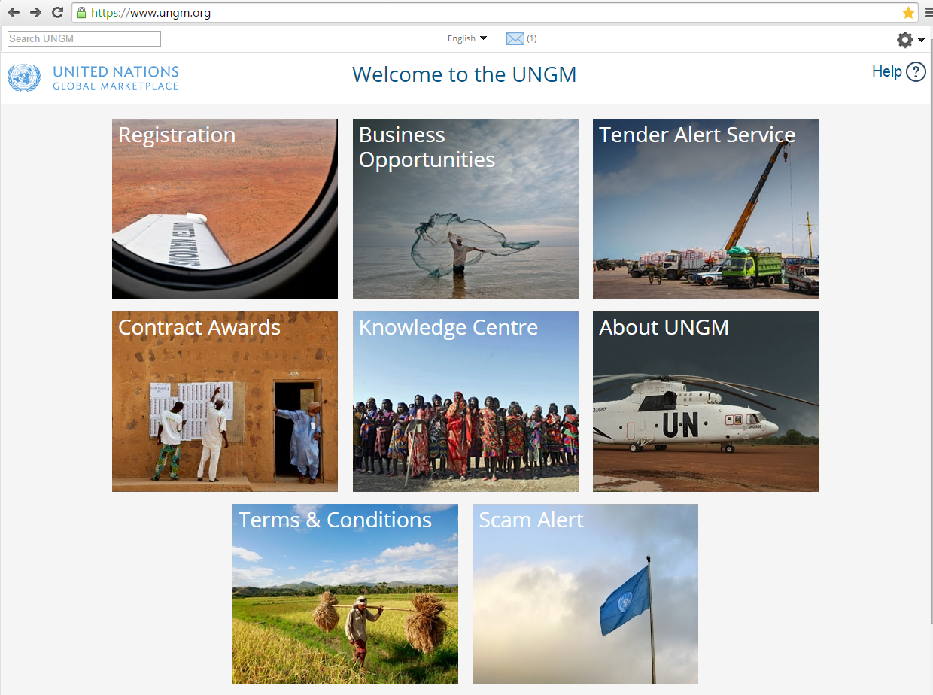



www.ungm.org

Slide 7

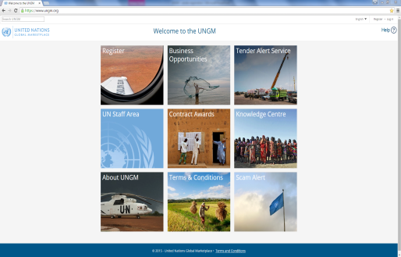
3
Registration process on UNGM
Free of charge
Intuitive
One of first steps in doing business with the UN
Easy
A requirement for more and more UN organizations in order to participate in tenders
FREE registration form online
available in 4 languages – English, Spanish, French and Portuguese
Guidance
User-friendly
Fast
United Nations Global Marketplace – www.ungm.org

Slide 8
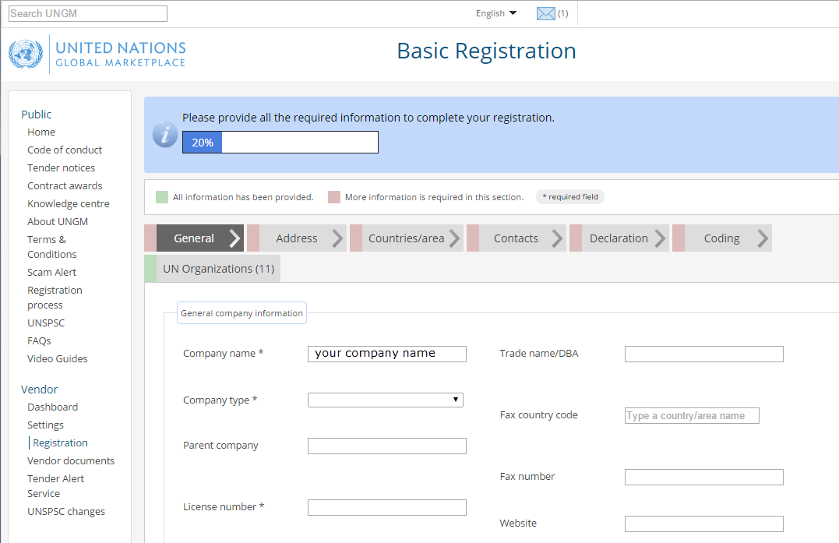
3
Registration process on UNGM
United Nations Global Marketplace – www.ungm.org

Slide 9

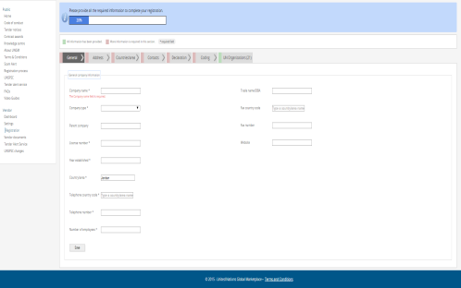
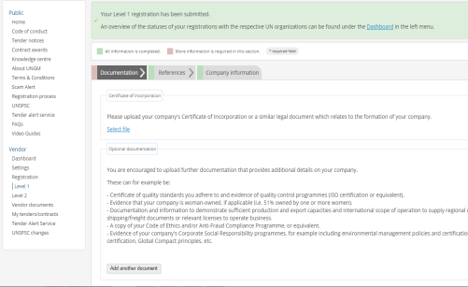
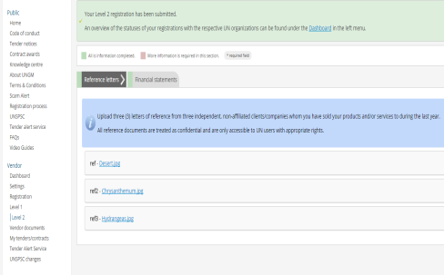
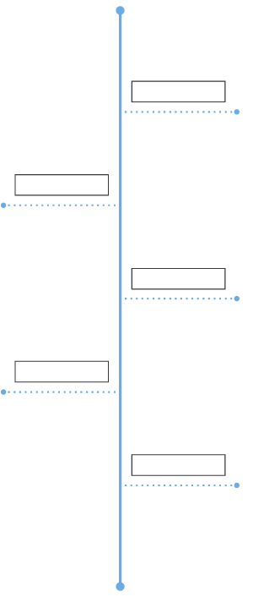

3
Registration process on UNGM
3 registration levels
Basic registration
Level 1
Level 2
Common registration process
Some UN organizations require additional information
Certificate of Incorporation, references, financial statements …
United Nations Global Marketplace – www.ungm.org

Slide 10

3
Tips when registering
Check your email address when registering. Wrong email address will make it impossible to create/activate account.
Ensure company name is correct.
Only accounts with one of more Registered status are visible to UN staff. Check status from Dashboard link.
Ensure your UNSPSC codes are specific and detailed.
Manage contacts.
Ask for help when in doubt.
United Nations Global Marketplace – www.ungm.org

Slide 11
www.ungm.org

Slide 12


4
Information on Business Opportunities
Keeping abreast of upcoming business opportunities
400 active notices at any one time
Free access to procurement notices
Limited access if
not registered with agencies using
e-sourcing
Published by 40 UN organizations and partners
United Nations Global Marketplace – www.ungm.org

Slide 13
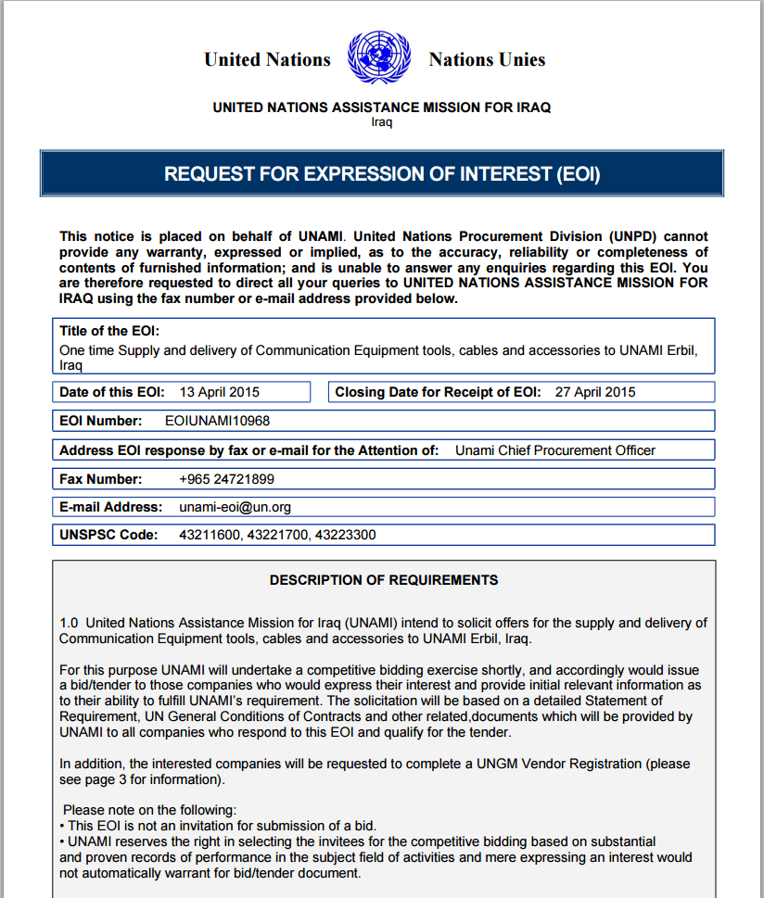
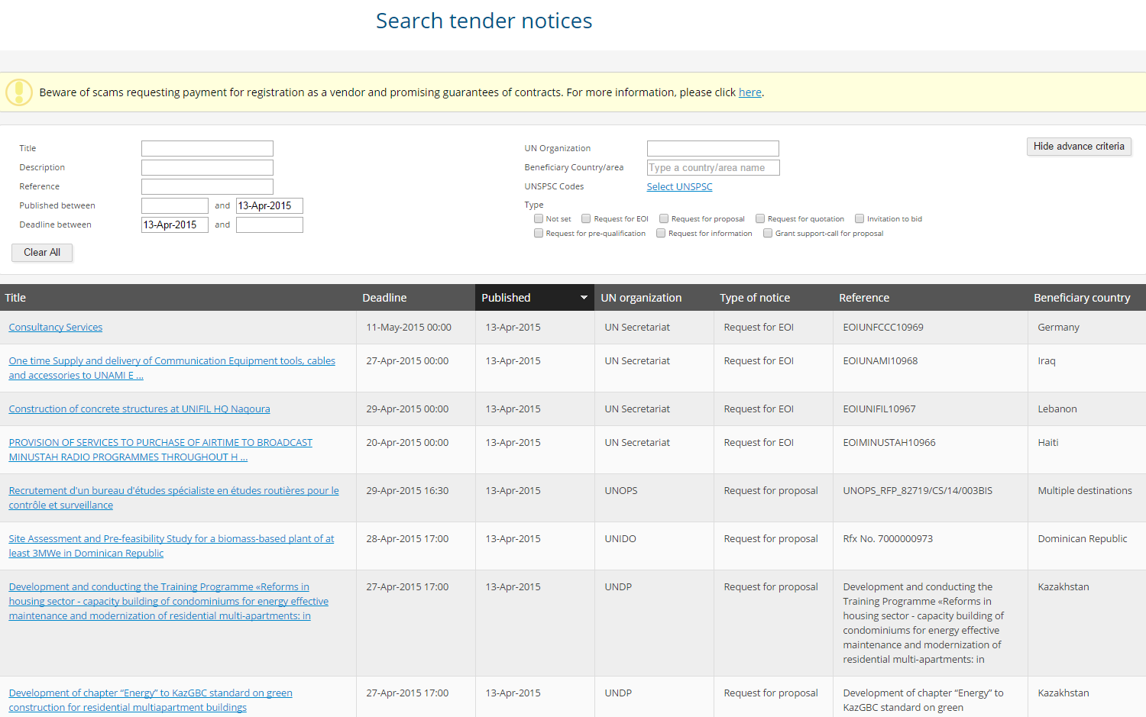
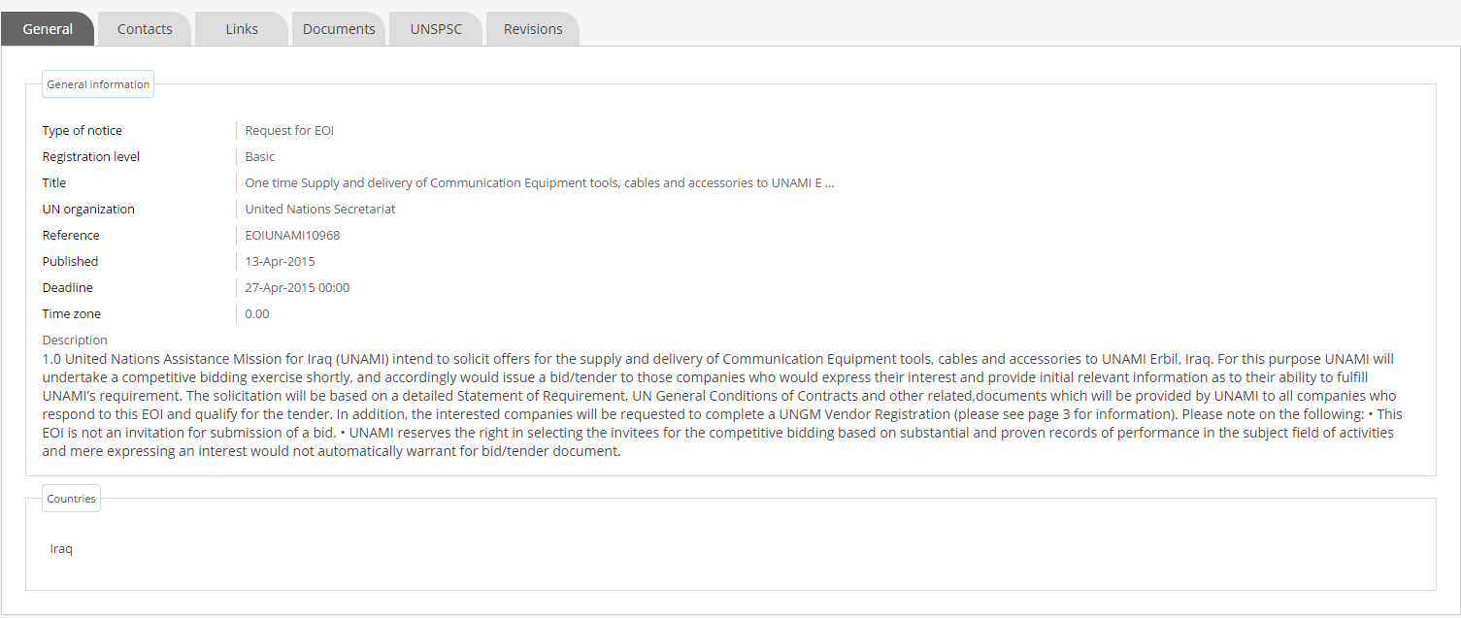
4
Business Opportunities/Tender Notices
Tender Notices on www.ungm.org
United Nations Global Marketplace – www.ungm.org

Slide 14


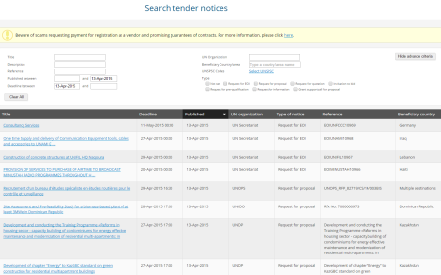



4
Tender Alert Service
Identifying relevant tender is a time-consuming task
Deadlines are often short
Tender Alert Service
Receive via email relevant
business opportunities as soon
as they are published
The subscription costs USD 125 a year if paid before 24 November 2016
United Nations Global Marketplace – www.ungm.org

Slide 15
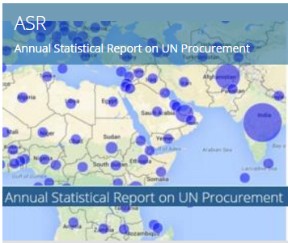
5
Other information
Knowledge center
Annual Statistical Report
Purchase orders and contracts (over USD 30,000)
UN procurement volume by country
Top ten items procured by UN agencies
UN agency procurement by country or commodity/service
United Nations Global Marketplace – www.ungm.org

Slide 16
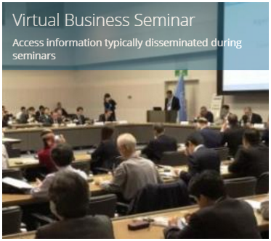
5
Other information
Knowledge centre
Virtual Business Seminar
Doing business with the UN in general
UN organisations and procurement rules
Sustainable Development Goals
Sustainable
procurement
United Nations Global Marketplace – www.ungm.org

Slide 17


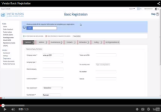


10
Contact UNGM
For more information, please visit www.ungm.org
Do you need assistance?
Check out our video guidelines and FAQs
For further assistance, do not hesitate to contact us:
  Via the Help functionality available on the site
  Via email at registry@ungm.org
United Nations Global Marketplace – www.ungm.org

