Slide 1
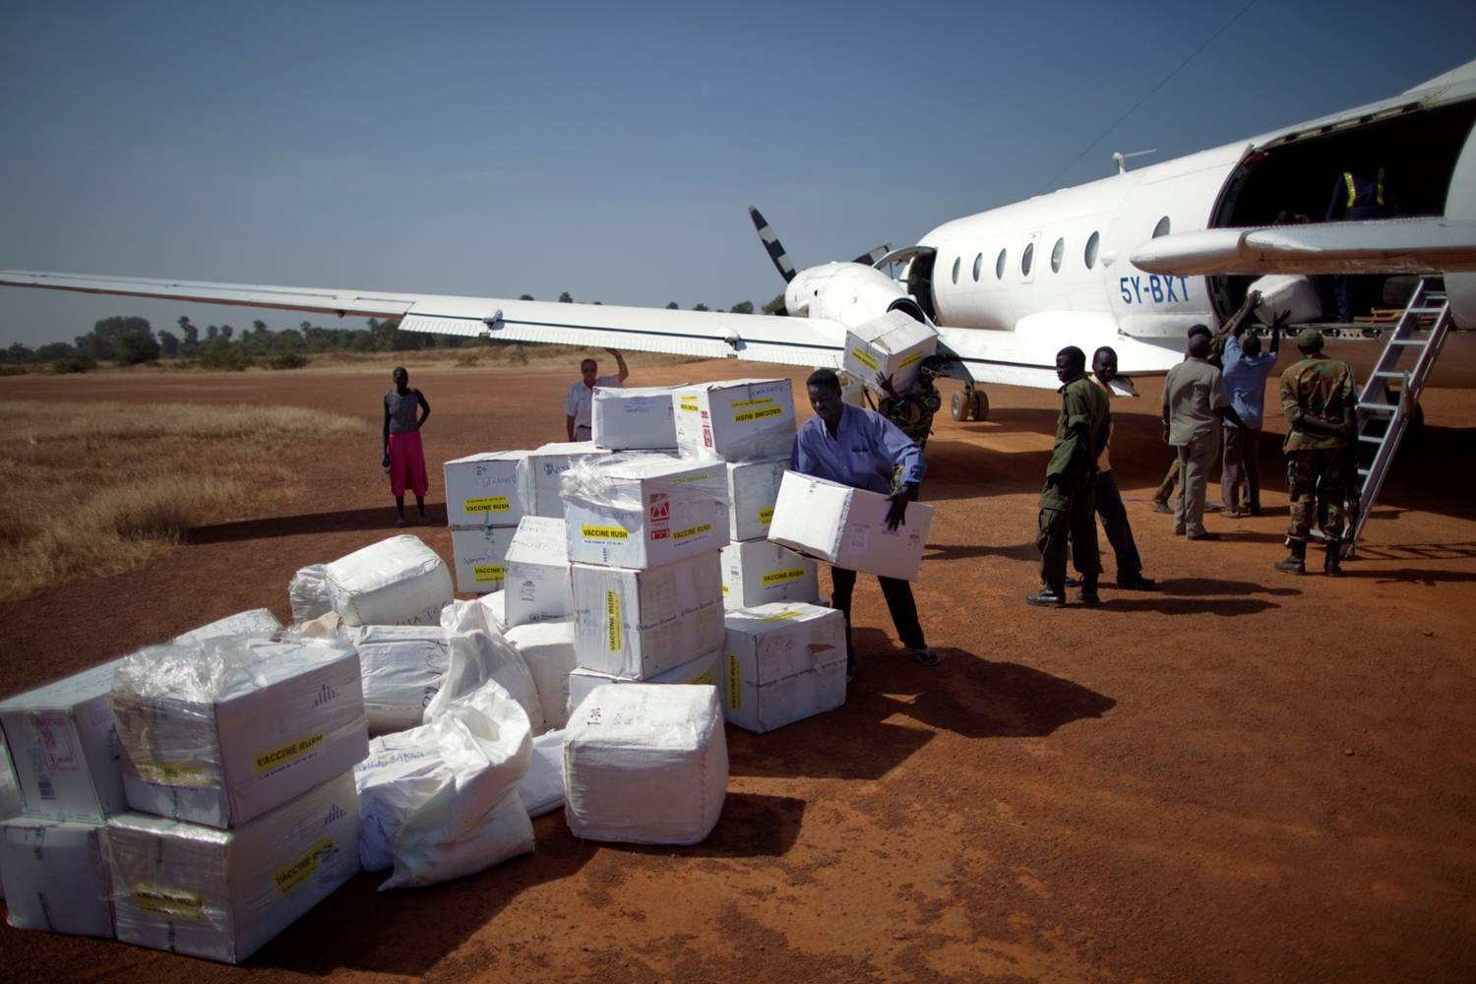
Doing Business with the United Nations (UN)
Kerry Kassow, High Level Committee of Management’s Procurement Network (HLCM PN)

Slide 2
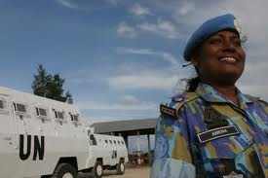
Agenda
UN Procurement & Statistics
Supplying the UN
Finding Information

Slide 3
High Level Committee of Management’s Procurement Network
The Procurement Network - Heads and Directors of 40 Agencies.
Focuses on:
Professional Development
Harmonisation
Sustainable Procurement
Strategic Vendor Management
UN Global Marketplace (UNGM)

Slide 4
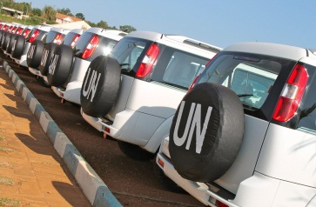
UN Procurement & Statistics

Slide 5
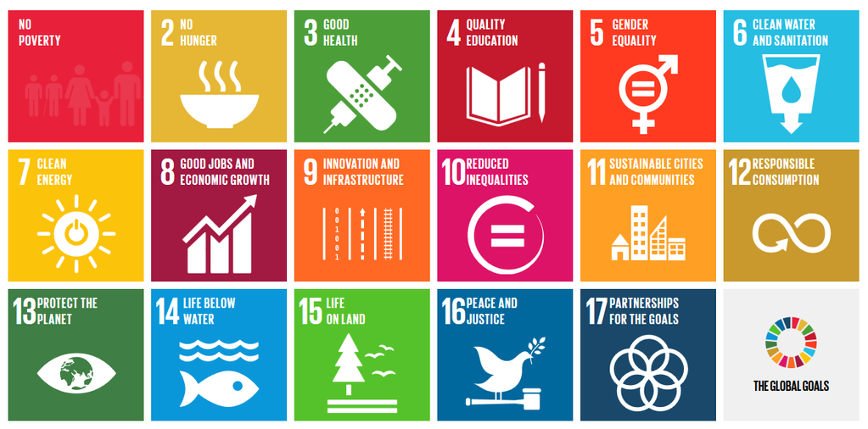
Procurement & United Nations ultimate goals
The Sustainable Development Goals 2015-2030
17 goals with 169 targets covering a broad range of sustainable development issues
https://sustainabledevelopment.un.org/
Notes:
The Sustainable Development Goals (SDGs), also known as the Global Goals,^{[1]} are an inter-governmentally agreed set of targets relating to international development adopted in September 2015. They seek to build on the Millennium Development Goals and complete what these did not achieve.
There are 17 goals in total with 169 targets covering a broad range of sustainable development issues. These include ending poverty and hunger, improving health and education, making cities more sustainable, combating climate change, and protecting oceans and forests.^{[2]}
Basically, they balance the three dimensions of sustainable development, that is, economic, social and environmental
Procurement is a relevant component of the common effort towards achieving the global goals and you will see that the work that the UN does, feeds into these goals and in turn the goods and services we are buying often relate to them.

Slide 6
The UN Global Compact and the Supplier Code of Conduct
The UN strongly encourages all vendors to actively participate in the Global Compact
The Global Compact promotes principles of human rights, labour, environment and anti-corruption www.unglobalcompact.org
The UN Supplier Code of Conduct spells out the principles that should inspire the business practice of suppliers
The UN Supplier Code of Conduct provides the minimum standards expected of suppliers to the UN
www.un.org/depts/ptd/code_of_conduct

Slide 7
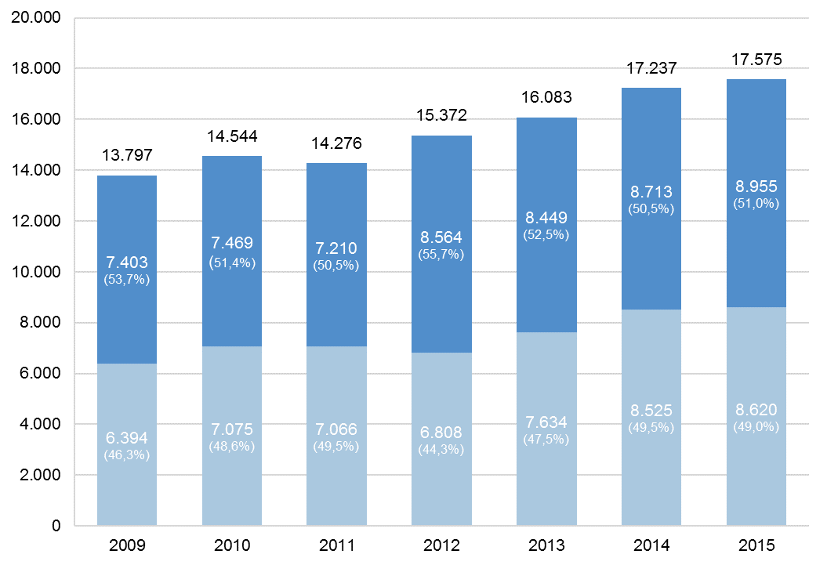
Total UN procurement of goods and services 2009-2015
USD Billion
Services
Goods
Notes:
This graph shows the UN procurement volume over the past 7 years. There tends to be a steady growth from year to year. The total volume in 2015 was over 17.5 billion usd with quite an even split between goods and services.

Slide 8
Procurement volume of the 10 principal UN organizations 2014 and 2015
USD Million
(total shown for 2015)
Notes:
Here you can see the procurement volume of the largest procuring agencies of the UN for the past two years.
The UN has many different organizations but these 10 account for over 90% of the UN’s total procurement volume.
Extra info:
UNFPA was the ninth largest UN organization in 2014. UNFPA’s volume in 2015 was $343 million compared to $357 million in 2014.
The significant increase in volume for the ILO is due to reconstruction of the ILO premises in Geneva. Their volume in 2014 was $148 million.

Slide 9
10 major countries of supply to the UN System 2015
USD Million
Notes:
Here you can see the 10 major countries that supplied the UN last year.
It is important to note that the UN procurement statistics are based on where the invoicing is taking place and not necessarily where the goods originate from.
And, typically in locations where there is a lot of UN activity, such as HQ locations, you will see a high procurement volume. This is why you will see the USA, Switzerland, UAE and Denmark here as the UN has significant procurement hubs in these countries.
India, on the other hand, has been very successful in its own right in becoming a major country of supply to the UN and has been in the top 10 for many years now.

Slide 10
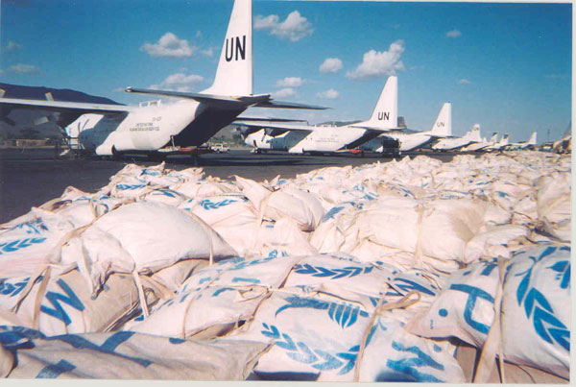
What does the UN buy?
Notes:
This chart shows the distribution of the UN’s procurement across the largest sectors of categories of goods and services.
Two sectors are larger than others: the health sector (which includes pharmaceuticals, healthcare services and medical & laboratory equipment) and the transport sector (encompassing freight services and motor vehicles).
Three other sectors also have a large share of the UN’s procurement volume, namely, construction and engineering, food & farming, and management & administrative services.
Combined, the 5 largest sectors account for about 3/4 of total UN procurement volume.
The UN is however buying a lot of other goods and services, so do not be discouraged if your business does not fall into the main 5 sectors.

Slide 11
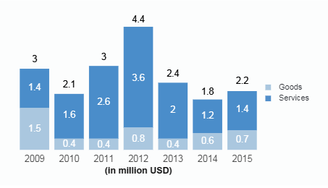
UN procurement from Poland
Main agencies buying from Poland
UNDP
WHO
WFP
UNICEF
0.01% of total UN procurement

Slide 13
Supplying the UN

Slide 14
Are you ready to supply the UN?
Market knowledge (UN structure and culture)
Suitable products/services
Export experience/references
Languages
Competitive prices
Networks/partners (country knowledge, after-sales services etc.)
Capacity (financial, personnel)
Intercultural skills
Flexibility
Accuracy
Persistence and patience

Slide 15
Step-by-step towards success
Market research, identify relevant UN
Organisations, register
Understand the procurement practices,
seek opportunities
Bid according to tender documents,
observe norms and standards, seek clarification
Performance

Slide 16
Finding Information

Slide 17
Web-based information
UN Procurement’s single commercial and procurement portal:
United Nations Global Marketplace (UNGM) www.ungm.org

Slide 18
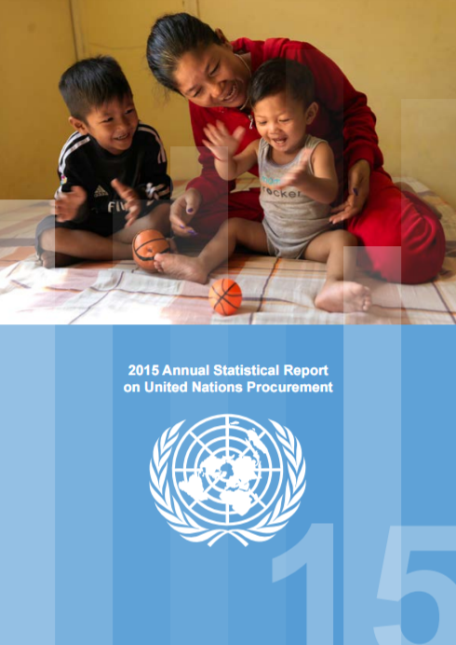
Business information
The Annual Statistical Report
UN procurement by country
UN Agency procurement by country, commodity or service
Purchase orders and Contracts (over USD 30,000) placed by agency, by country of vendor, value and description of goods or services
Top Ten items procured by Agency
Virtual Business Seminar Area
Meet the UN Agencies, fields of activity, procurement activities, statistics, tenders etc.
Available from www.ungm.org

Slide 19
Thank you!
Contact: kerry.kassow@undp.org

