Slide 1

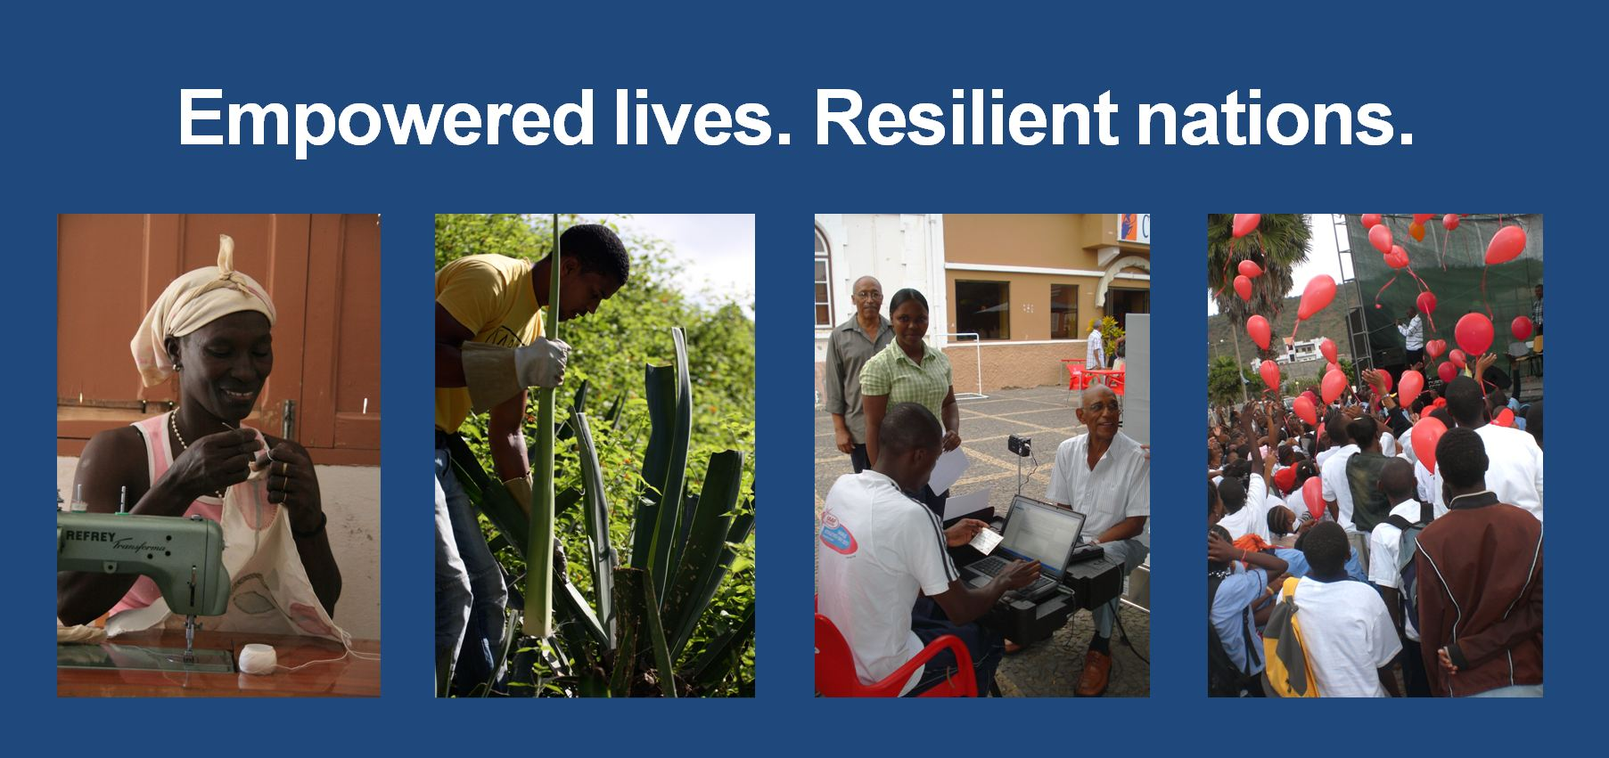
United Nations Development
Programme - Procurement

Slide 2

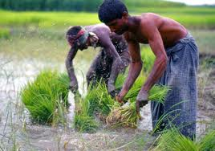
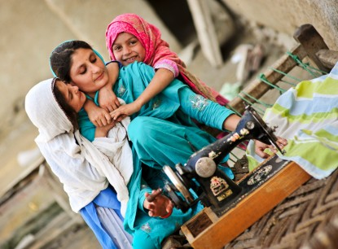
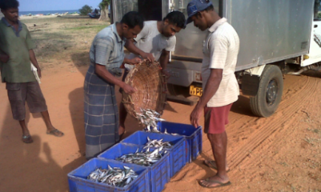
Scope of Presentation
1. UNDP - who we are?
2. UNDP procurement
3. How to do business with UNDP

Slide 3

UNDP at a glance
170+ The number of countries and territories where UNDP is working on the ground
3 Primary Focus Areas:
Sustainable development
Democratic governance and peacebuilding
Climate and disaster resilience
UNDP is committed to support
the 2030 Agenda for
Sustainable
Development and the 17
new Sustainable Development Goals

Slide 4
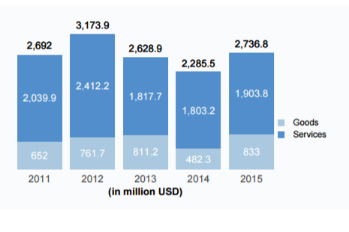
Procurement Trend (million USD)
Agency with the 3rd largest
procurement volume 2015

Slide 5
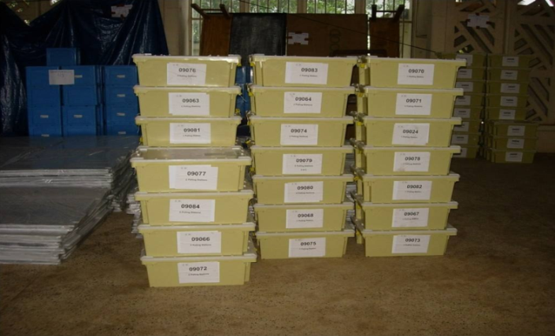
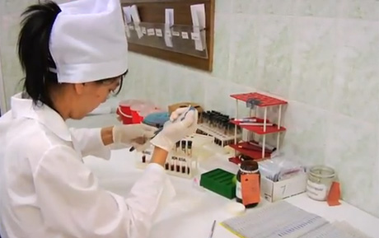
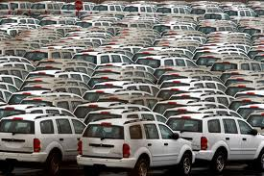
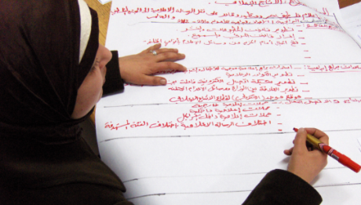
Which are the major products?
Pharmaceuticals
Laboratory & Medical Equipment
Vehicles & Parts
IT Equipment
Election Equipment

Slide 6

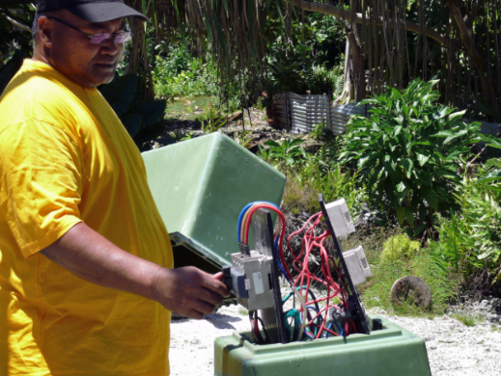
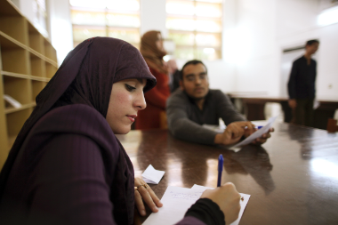
Which are the major services?
Management & Administration
Construction & Engineering
Transport
Travel

Slide 7
How is procurement organised?
Decentralized to of our country offices (140)
Every country office is a potential business partner
Specialised HQ procurement centres (health, crisis prevention & recovery, elections, energy and environment)
70% of total spend with top 30 country offices
Consult and review their websites at www.undp.org

Slide 8
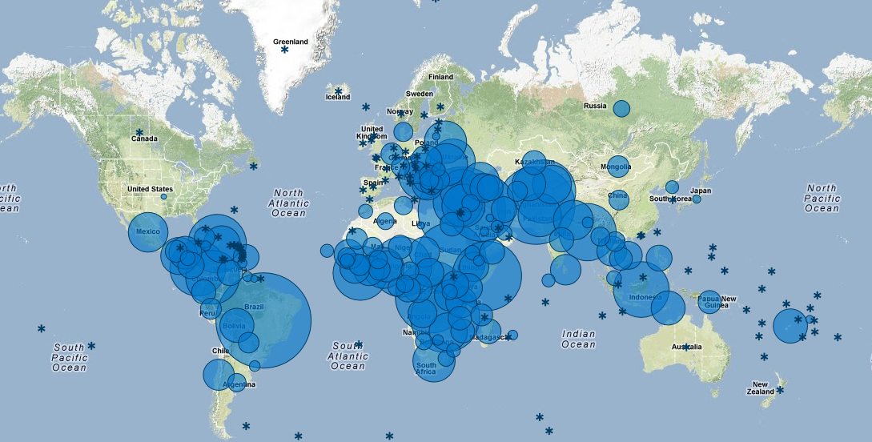
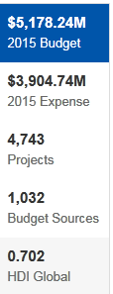
UNDP has a truly global profile
Visit http://open.undp.org

Slide 9
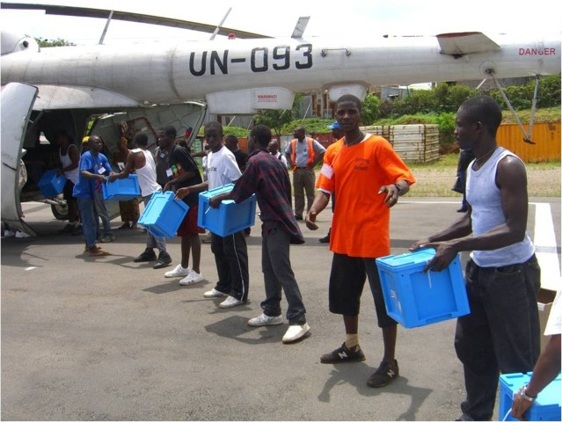
Procurement Services Unit (PSU)
Copenhagen, Denmark
Procurement support to Country Offices (advise, training and procurement and supply services)
New York, USA
The main responsibility of the Procurement Services Unit in NY is policy-making and oversight
Regional representation
Kuala Lumpur - operational procurement support
Regional advisors

Slide 10
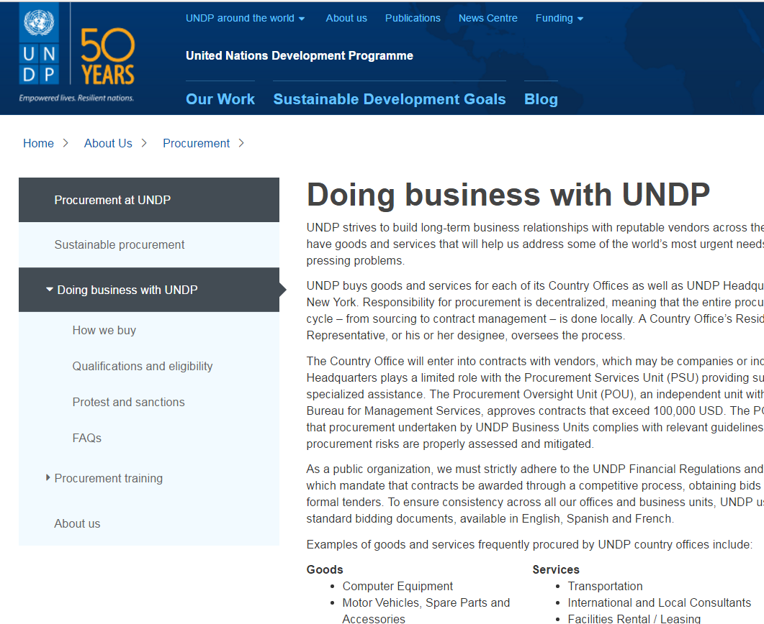
How to do Business with UNDP

Slide 11
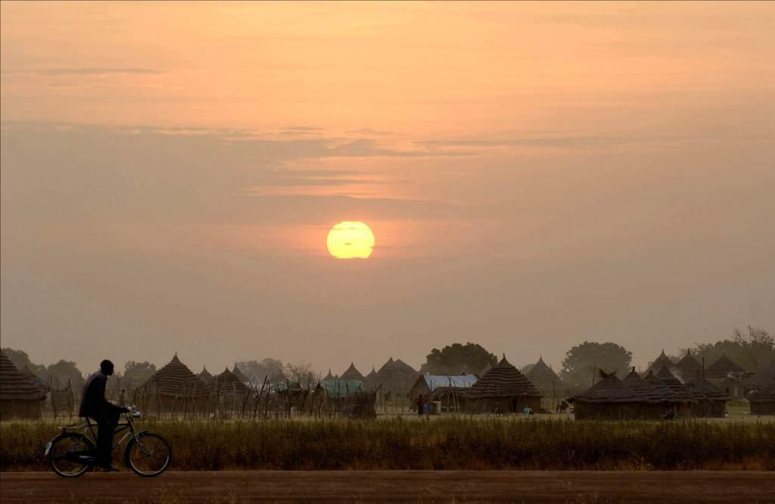
Resources
THANK YOU!
Learn about UNDP’s projects by country, project, funding source: http://open.undp.org
UNDP procurement website: www.undp.org/procurement
Procurement Notices above USD 100K are advertised:
http://www.ungm.org
http://procurement-notices.undp.org
Procurement training: www.training.undp.dk
Annual statistics: www.ungm.org
Procurement Manual: UNDP procurement manual

